Slide 1

Managing Diabetes in Safety-Critical Tasks
Ensuring health and safety in high-risk professions
UIMC Medical congress
Ireland, October 2025
K. SAKTHITHASAN, V. JOUANNIQUE

Slide 2
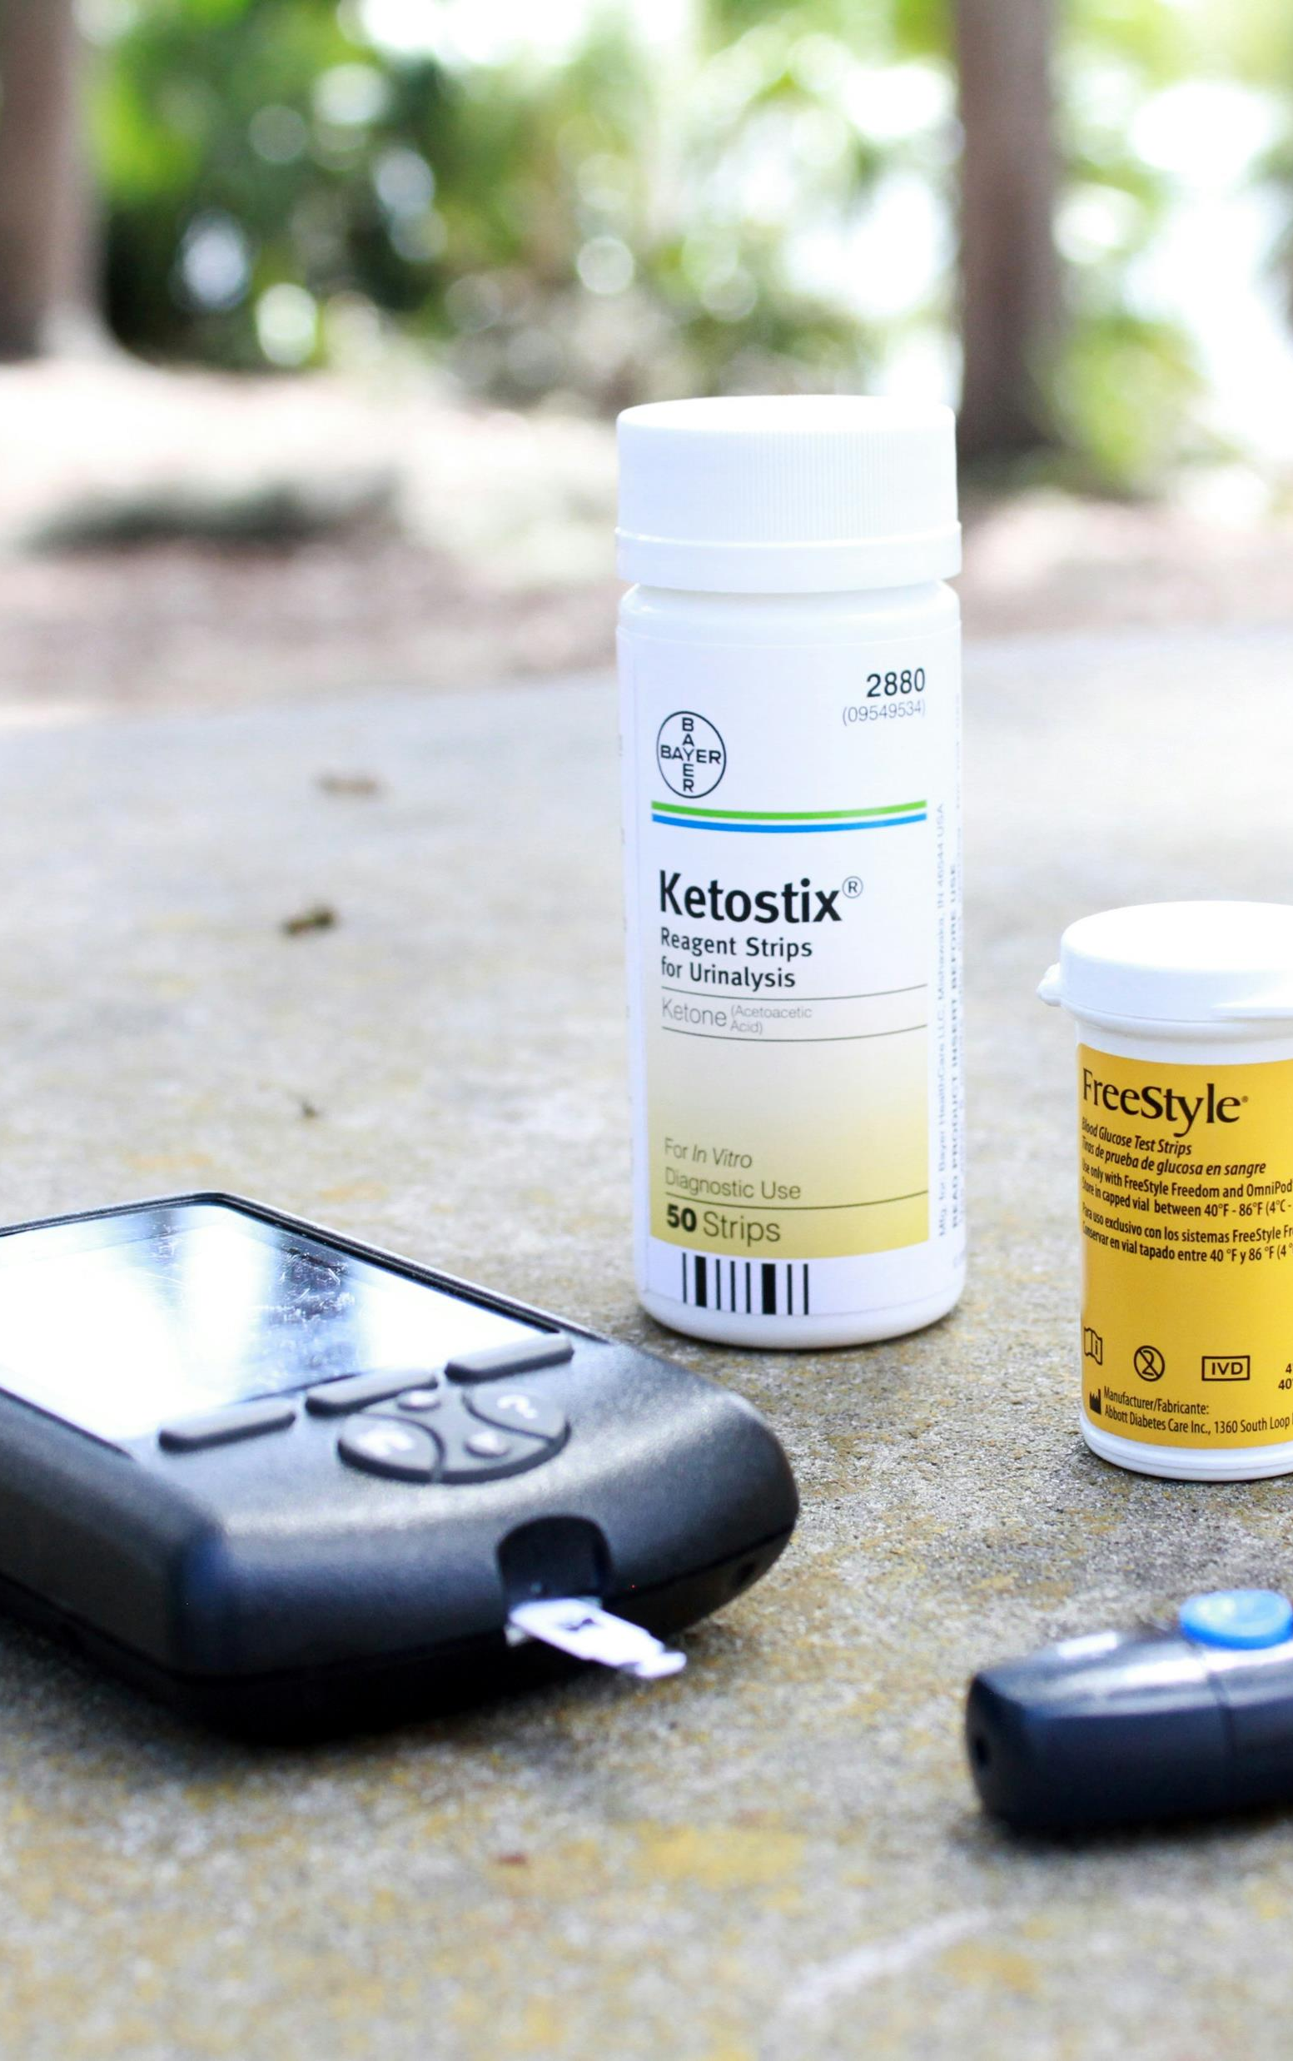
Overview of Diabetes in Safety-Critical Tasks
Safety Challenges in safety-critical tasks
Historical Regulatory Exclusions (risk of hypoglycemia, outdated treatment concerns, lack of individual consideration)
Advancements in Diabetes Management

Slide 3
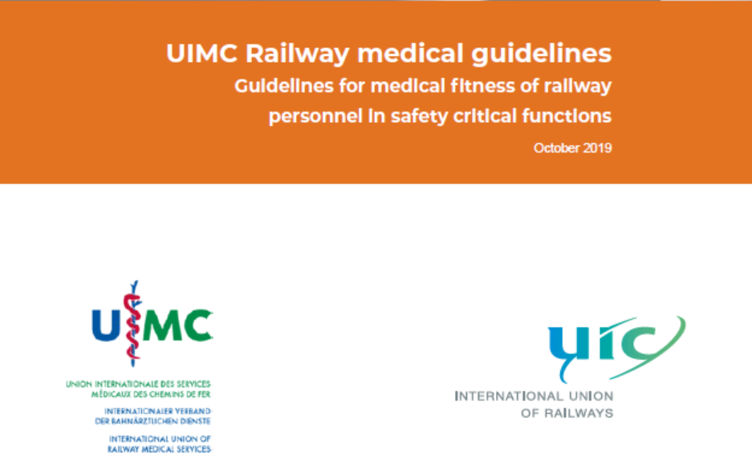
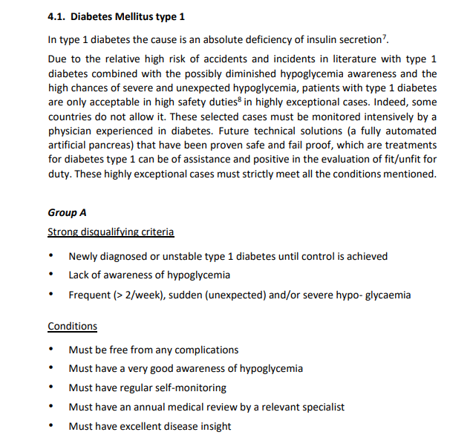
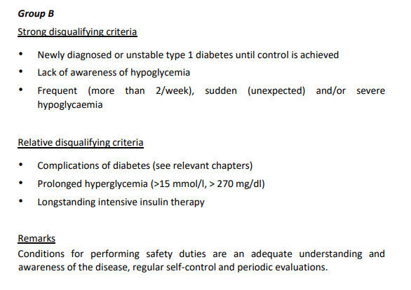
UIMC Guidelines

Slide 4
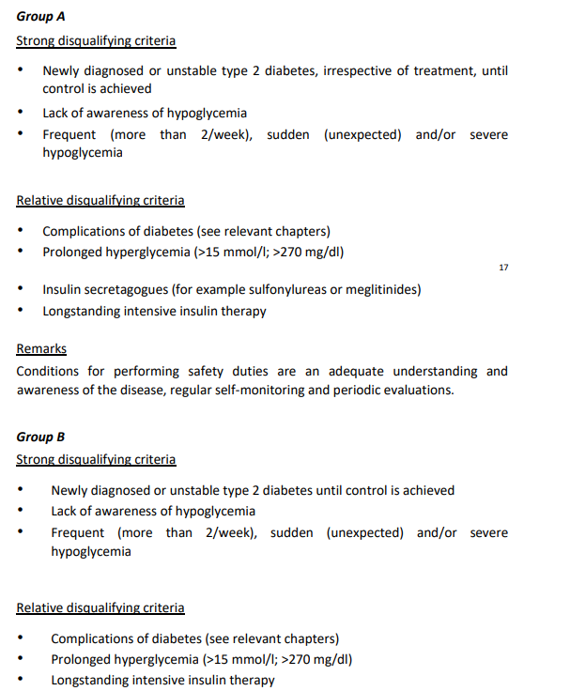
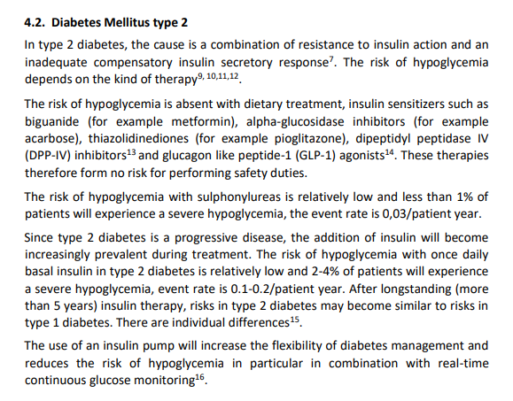
UIMC Guidelines

Slide 5
French regulations for driving license
Car Licence | Bus Licence
Diabetes treated with medication likely to cause hypoglycemia Incompatibility if severe hypoglycemia or impaired awareness of risks related to hypoglycemia and emergency management. Temporary compatibility subject to: Adequate control of the disease (especially blood glucose monitoring before driving) Awareness of hypoglycemia risks, ability to detect and treat any hypoglycemia so that it does not occur while driving No other diabetes-related complications incompatible with driving | Incompatibility if severe hypoglycemia or impaired awareness of risks related to hypoglycemia and emergency management during the last 12 months Temporary compatibility (maximum 3 years) subject to: Adequate control of the disease (especially blood glucose monitoring before driving) Awareness of hypoglycemia risks, ability to detect and treat any hypoglycemia so that it does not occur while driving No other diabetes-related complications incompatible with driving Special attention is given to compatibility between treatment and work schedules.

Slide 6
French regulations for trains drivers
The physical fitness of the train driver will be assessed by the physician on a case-by-case basis, based on the list below, taking into account the driver’s health condition, therapeutic advances, and, if necessary, after obtaining a specialist’s opinion for diabetes treated with insulin or sulfonylureas.

Slide 7
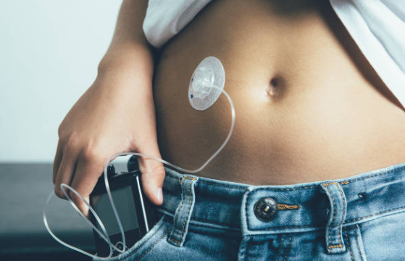
Advancements in Type 1 Diabetes Management
Insulin delivery systems (open-loop or closed-loop systems)
Real-time CGM (Continuous Glucose Monitoring) integration
Ultra-rapid insulins
Structured education programs

Slide 8
Focus on insulin pumps
Open-Loop Systems | Closed-loop Systems
Manual insulin delivery based on pre-set basal and bolus rates Advantages: • Greater user autonomy and control • Widely available and cost-effective Disadvantages: • Requires frequent manual adjustments • Less responsive to real-time glucose changes • Higher risk of human error | Automated insulin delivery using CGM and algorithms Advantages: • Improved glycemic control and reduced hypoglycemia • Lower mental burden for users Disadvantages: • Higher cost and maintenance requirements • Dependence on technology and calibration • Risk of system failure
Impact of Electromagnetic Fields on Insulin Pumps?

Slide 9
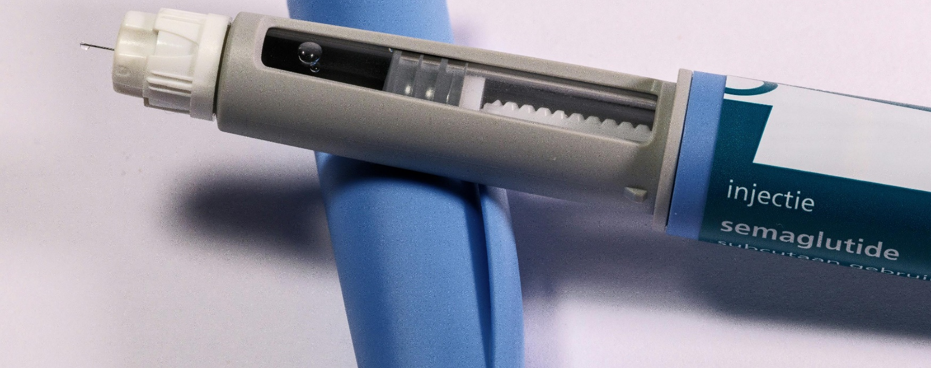
Advancements in Type 2 Diabetes Management
GLP-1 receptor agonists
SGLT2 inhibitors
Long-acting basal insulins
Lifestyle and education programs

Slide 10
Structured Patient Education
Diabetes Symptom Recognition
Understanding Treatment Regimens
Enhanced Self-Efficacy
Workplace Safety and Awareness

Slide 11
Clinical cases
A train maintainer, responsible for operating trains within the depot, experienced a medical emergency while onboard. The individual was equipped with a closed-loop insulin pump system, which relies on continuous communication between a glucose sensor, an insulin pump, and a smartphone interface.
On the day of the incident, the smartphone was left at a distance, disconnected from the system. As a result, the pump could not receive real-time glucose data or deliver insulin adjustments. The employee suffered a sudden hypoglycemic episode, leading to a loss of consciousness.
Fortunately, colleagues nearby intervened quickly, securing the train, alerting emergency services, and providing initial support until medical help arrived.

Slide 12
Clinical cases
A traffic manager working in a Centralized Command Post (PCC) who has Type 1 Diabetes uses a closed-loop insulin pump system.
He explained that the system often requires manual dose adjustments, particularly during peak operational hours when stress levels and physical activity fluctuate unpredictably. The algorithm does not always adapt to these variations, resulting in episodes of glycemic instability.
Additionally, he reported software bugs in the pump interface and frequent crashes of the smartphone app, which is essential for monitoring and controlling the system.
How reliable are diabetes technologies in real-world, high-stress environments?

Slide 13
Reevaluating Hypoglycemia Risk
Decreased Hypoglycemia Risk
Need to Update Policies
Individualized Risk Assessments

Slide 14
Variability in Practices
Need for Harmonization
  Evidence-based guidelines can harmonize practices, promoting fairness and ensuring capable individuals are included.
  Legal and Ethical considerations
  Balancing Safety and Rights
  Avoiding Discrimination
  Legal Standards and Certification

Slide 15
Recommendations for Integration
Use of CGM Devices
Education Programs
Flexible Occupational Guidelines with individualized risk assessments

Slide 16
Proposal : Establish a Working Group on Diabetes Management
Create a dedicated space to discuss approaches across different countries, review current practices and share our experience.
Why?
Diabetes care is evolving – our recommendations should evolve too.
Practices vary significantly between countries and healthcare systems.
Next step
Identify best practices, maybe co-develop more inclusive and effective recommendations

