Slide 1

Reintegration at the workplace – part-time reintegration act in Austria
Dr Gertraud Alexandra Hedenetz, MSc.
30 September 2026 UIMC congress Lisbon
UIMC

Slide 2
Program „Reintegration“
„Definition“ and conditions
WIETZ= part time reintegration: objective
legal conditions/framework/pitfalls/success factors
Role of occupational medicine
Assessment of resilience + adaption of /at workplace (technical, time-related, organisational)

Slide 3
Reintegration
Which „type“ of reintegration?
Differences: Legal/financial/content/organisational!
A) Company/group/… internal regulation and naming
individual
Requirements
Forms
Concessions: e.g. no heavy lifting, no night shifts, … but FULL working hours!
B) „ protected workplace“ by General Work- Accident insurance agency (AUVA) (actively offered by AUVA)
C) WIETZ (WiederEingliederungsTeilZeit = part time reintegration act )
Legally regulated
Requirements
Forms
Concessions: ALL activities without restriction, but PART-TIME

Slide 4
WIETZ = reintegration on part-time job
Definition:
Gradual return (slow increase in working hours) to work following a prolonged period of illness
GOAL: Regaining the original timeframe of working hours!
Objective:
(Early) return to the work process (= rehabilitation) through gradual reintegration
Benefits for the employer: experience and work force; pays only equivalent amount (working hours)
Benefits for the employee: ‘ergo- therapy’; time for therapy/recovery; income; return to ‘normality’! (daily routine, tasks, …)

Slide 5
WIETZ conditions
At least 6 weeks’ continuous sick leave
employment contract for at least 3 months
Confirmation of fitness for work required! (sickness absence ended)
Written agreements: return-to-work plan and –agreement (amount and time of work hours, payment)
Confirmation from Fit2work or Occ Med (recommended/not recommended):
ONLY if outcome is „medically useful/promising” (Prognosis!?)
approval by health insurance (Chief Medical Officer)
NOT legally entitled ! (company can decline the request)

Slide 6
WIETZ framework
Reduction of at least 25% – up to 50% of previous working hours (working hours min. 12 hours per week or during the calculation period!)
Time-limited:
min. 1 – max. 6 months
+ 1 extension of 1–3 months maximum possible
max. 2 amendments to the already approved plan are permitted
Application up to 1 month after return/start of work (but only applicable once approved by health insurance!)
€: aliquot salary from employer / remainder as reintegration allowance from health insurance
Earlier return (than planned) to original amount of working hours possible: at least 3 weeks notification
Protection against dismissal on grounds of WIETZ
New entitlement 18 months after the end of the previous WIETZ

Slide 7
WIETZ process/pitfalls/success factors
Reintegration is addressed by GP/Specialist/employee/manager/HR/occ med/occ psy …:
Occ med: DO NOT make any promises and
DO NOT fill in any forms in advance
→ IT IS ESSENTIAL to first consult manager/HR/…
Preparation of reintegration plan and - agreement by HR and employee, with the consultation of Occ Med
Submission of application to the Health insurance by employee him/herself or HR (electronically or in person)
In good time! (allow at least 1 week for approval!)

Slide 8
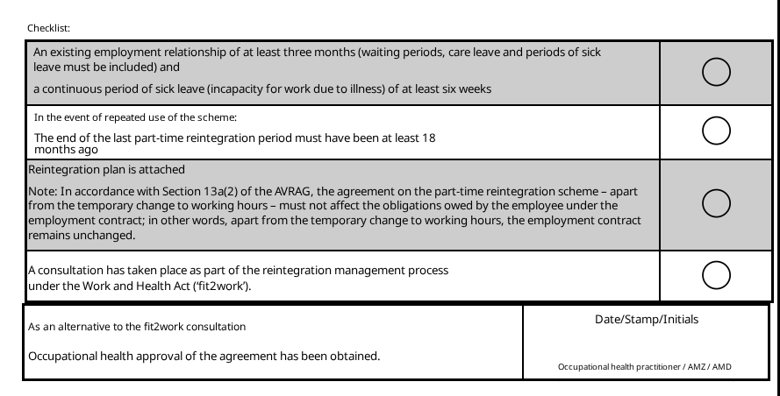
AMED Reintegration Agreement
Source: Screenshot of health insurance form

Slide 9
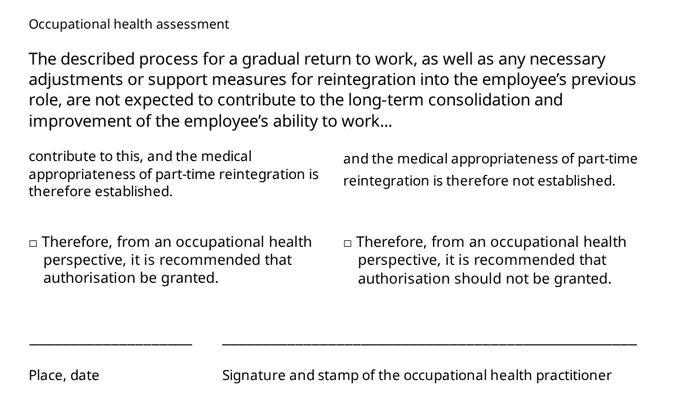
AMED Return-to-Work Plan
Source: Screenshot of health insurance form

Slide 10
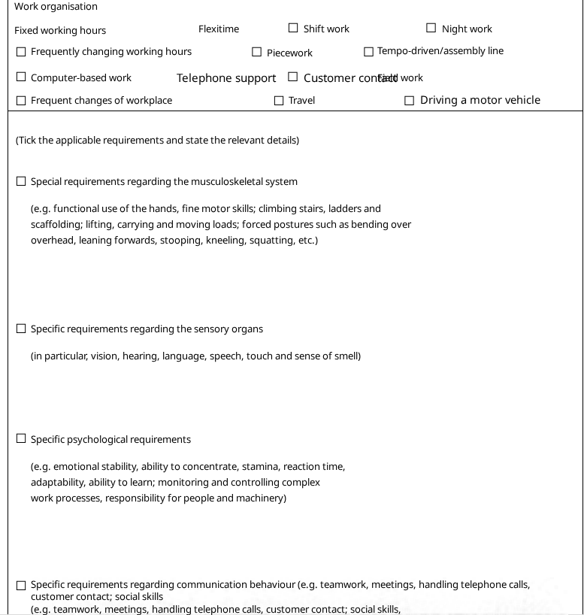
Assessment of resilience
Reintegration plan
To be assessed in accordance with the form!
if possible specialist reports with explicit statement regarding WIETZ
in person where possible
Physical resilience
Ability to concentrate
Memory
Reaction time
Risk of infection
Fatigue!
Source: Screenshot of ÖGK form

Slide 11
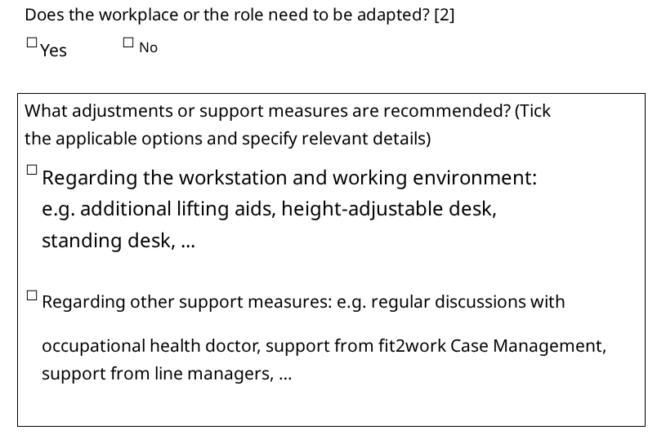
Workplace adjustments (technical, time-related, organisational)
Ergonomic workstation design and assistive devices (motor, digital, etc.)
Additional breaks
Start and finish times (shift work, part-time)
Home office
Regular consultation between staff and Occ Med
Source: Screenshot of ÖGK form

Slide 12
Experience
WIETZ started too early
Underestimating the strain caused by commuting
Increase in working hours too fast
In the case of a full-time job, a large gap between 75% working hours to 100% (30 hours → 40 hours)
Based on medical reports/prognosis, no prospect of success for WIETZ – unrealistic expectations
Difficult organisational implementation within the company due to fixed shift lengths and scheduling constraints
abuse of the system
…..
….
….

Slide 13

Thank you for your attention!

Slide 14
Sources
Professional experience
RIS – Part-Time Reintegration Act, Federal Law Gazette I No. 30/2017 – Federal Law Gazette (authentic version from 2004 onwards)
BGBLA_2017_I_30.pdf
Part-time reintegration & reintegration allowance austrian health insurance
Reintegration Agreement Austrian Social Insurance website
Reintegration Allowance – WKO

Slide 15
Handout | WIETZ in brief
Legal CONDITIONS
• At least 6 weeks of continuous sick leave
• Employment contract for at least 3 months
• Fit for work certificate
• Reintegration plan and
-agreement in writing
• Medically , recommended and approved by health insurance provider
• No legal entitlement
FRAMEWORK
• Reduce working hours by 25–50% ; at least 12h/w week (or average during calculation period)
• Duration: 1–6 months; one-off plus 1–3 months
• plan may be amended twice
• Start after approval; application within 1 month of return
• aliquot salary plus WIETZ funding –tax implications!
• Early return to ‘full-time’ no sooner than 3 weeks after application
PROCEDURE
• Initiated by the employee, line manager, HR, treating doctors or occupational health service
• Occupational Health: no advance promises and no forms to be completed in advance
• First step: consultation between employee and manager / HR
• Draw up a WIETZ- plan and
-agreement jointly
• Submit application to health insurance via employee or HR
• Allow at least 1 week for approval
Sources: RIS – WIETZ Act (Federal Law Gazette I No. 30/2017); ÖGK – Part-time work and allowance for reintegration; Social Insurance – Reintegration Agreement; WKO – Reintegration allowance.

