Slide 1
Sleep apnoea in rail workers- improved screening causing fitness dilemmas
Dr Anand Ramesh, Dr Isabella Fernandes, Dr Manuel Fernandes
AAFER Ltd, United Kingdom

Slide 2
Case 1
48 year old train driver- previous history of sleep apnoea (severe on AHI criteria, pre treatment AHI 37), on CPAP. Completely asymptomatic even prior to treatment aside from mild snoring.
Epworth score was 4
Discovered at periodic medical that was no longer compliant with CPAP due to tolerability issues with mask so deemed unfit for duties temporarily
Re-established on CPAP which brought AHI back down to <15
However continues to have significant tolerability issues

Slide 3
Case 1
Numerous visits to sleep clinic- trialling different CPAP masks and setups, but none seem to suit him and told no further adjustments can be made
Significantly affecting compliance with his CPAP and finds CPAP actually makes his sleep quality worse and makes him more tired. Challenging consultations as does not want to continue with treatment
States he has lost a significant amount of weight and does not feel needs CPAP anymore
Letter from his respiratory specialist states that they did not feel treatment was necessary from a symptom perspective…

Slide 4
“In summary from an obstructive sleep apnoea point of view because he is not symptomatic, there are no restrictions on the driving but in terms of his work related purposes I realise he is a train driver, so the other work related situations would have to be assessed by their occupational health team and I am unable to comment on that”

Slide 5
Case 1
Next steps:
-Discussed with sleep consultant and agreed to repeat a sleep study off all CPAP to gauge severity of sleep apnoea
-Pending this advised must remain on CPAP, and having monthly OH reviews with review of compliance data and AHI

Slide 6
Case 2
52 year old male train driver
Periodic medical: noted to have high STOPBANG score (6). Completely asymptomatic, no history of daytime sleepiness. Epworth score 3
Sleep study recommended and referred via railway company to local sleep clinic
Sleep study confirms moderate sleep apnoea (AHI of 23)

Slide 7
Case 2
OH outcome:
-Stepped down from driving and referred for treatment of sleep apnoea
-Review after 1 month on CPAP and return to work contingent on AHI dropping to below 15

Slide 8
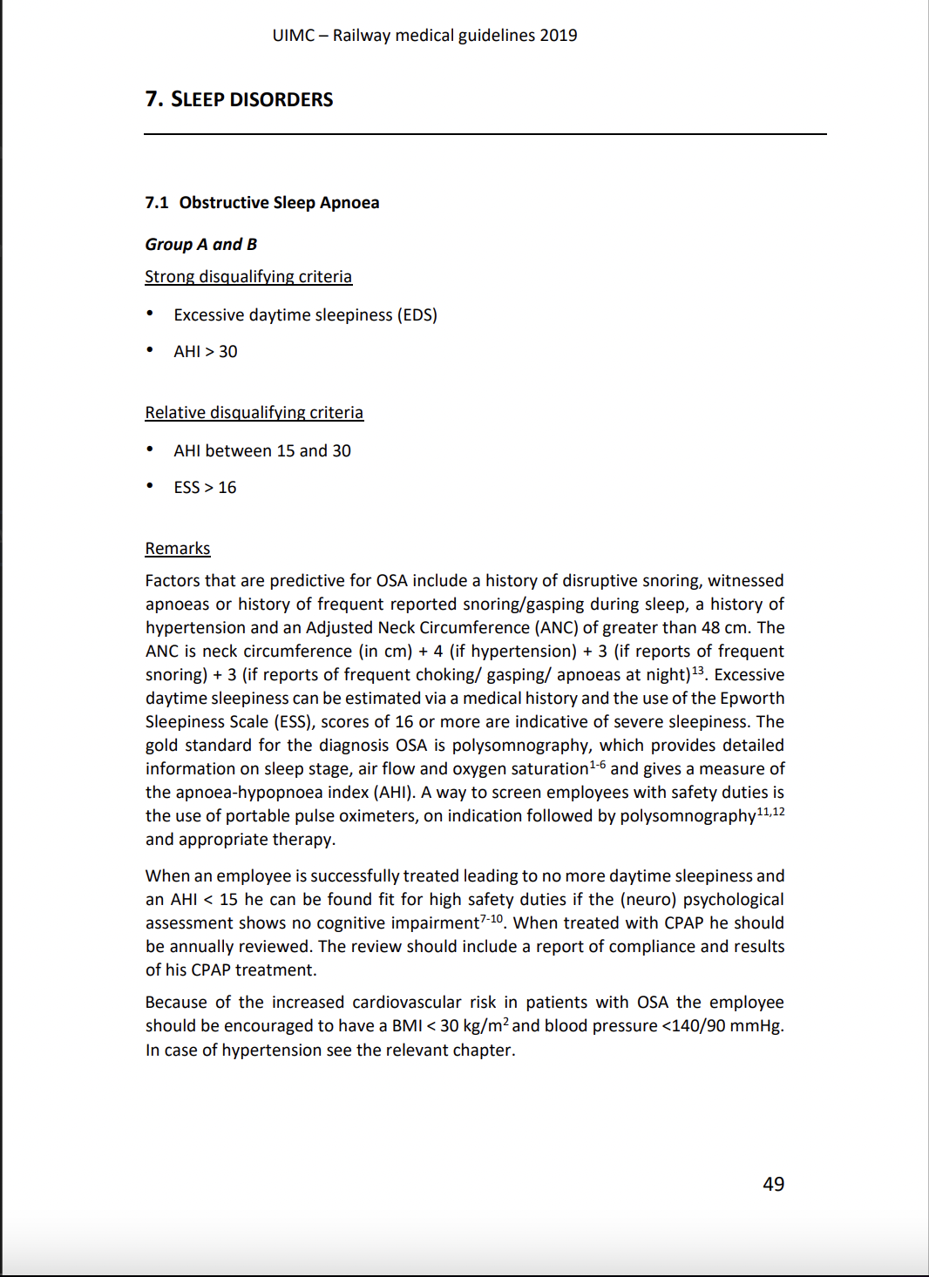

Slide 9
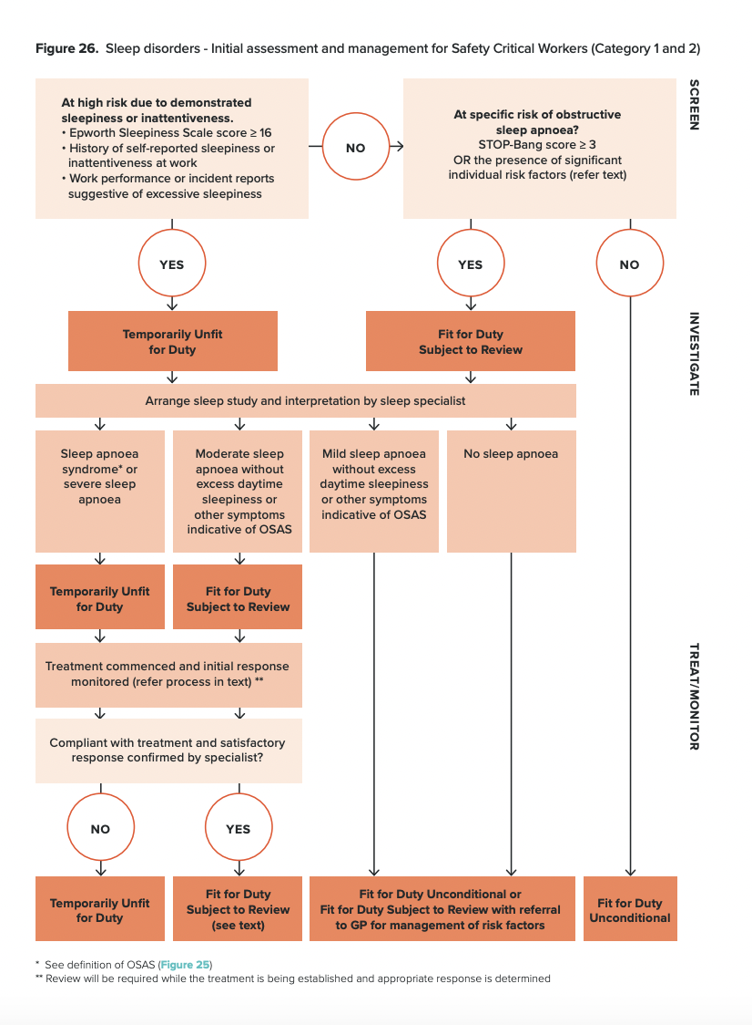

Slide 10
Issues raised
Routine STOPBANG screening resulting in increasing numbers of completely asymptomatic drivers with diagnoses of sleep apnoea
There is still no definitive consensus on whether treating asymptomatic sleep apnoea is beneficial
Challenge of how to manage occupational fitness decisions in individuals with “moderate sleep apnoea” on AHI criteria but with no symptoms, where guidance seems to differ slightly or can be interpreted differently
UIMC describes an AHI of >15 as a “relative disqualifying criterion” for safety critical workers- open to interpretation regarding whether has to be treated first or if can continue driving pending treatment
Australian standard is clearer in that if asymptomatic and AHI 15-30, can continue to drive pending treatment

Slide 11

Our current approach
Currently we adopt an interpretation of UIMC standards which is to treat moderate sleep apnoea on AHI criteria as a disqualifying criterion to drive trains until treated to below 15, even if completely asymptomatic
Imperfect approach, as we have asymptomatic drivers having to be passed unfit until treated
Treatment is also not straightforward and results in tolerability issues in some cases/worsens their sleep

Slide 12
Questions for colleagues
How do you approach the driver with ”moderate sleep apnoea” on AHI criteria who is asymptomatic? Can they continue to work pending treatment, or step down pending treatment?
Can we make sleep apnoea screening more targeted/be more selective in who we send for sleep studies - ?only patients with overt symptoms/very high stopbang scores (most UK male train drivers get a high score!)

Slide 13
Any other questions?

Slide 14
Thank you for listening

