Slide 1

Janos Hajdu M.D. – Hungarian Railway Healthcare Ltd.

Slide 2
Color Vision Deficiency in Railway Transport: Medical Reality, Ergonomics, and Over-Regulation
A Critical Appraisal
Historical Myths
Visual Psychophysics
Occupational Ergonomics
Janos Hajdu M.D. – Hungarian Railway Healthcare Ltd.

Slide 3

Executive Summary: The Core Conflict
  Regulatory Paradox in Hungary (Government Decree No. 203/2009) - Rigid national regulations for Colour Vision Deficiency (CVD)
  In Hungary CVD is a disqualifying factor for more than 100 railway job positions, regardless of its severity
  EU Directive 2007/59/EC on the certification of train drivers and Commission Implementing Regulation (EU) 2019/773 on the technical specification for interoperability relating to the operation and traffic management subsystem establish appropriate color vision criteria for a smaller number of job categories!
  There was a technological shift: LED signals, cab signaling, digital communications, etc.

Slide 4
Executive Summary: The Core Conflict
  GOAL:
  Demonstrating that congenital CVD poses no measurable risk in the vast majority of modern railway jobs.
  Cole, B. L., & Maddocks, J. D. (2008), "Color vision testing and the safety of transport workers," Clinical and Experimental Optometry, 91(1), 16–24; - confirms that the perception of modern, high-saturation LED lights is excellent among individuals with color vision deficiency due to adequate contrast!
  To bring about changes at the legislative level

Slide 5

Occupational Screening Pitfalls in Transportation SECTOR
Little information showing the real, practical performance of individuals with color vision deficiency in railway operations; This excludes 8 % of people
Color vision is a subjective sensation;
There is no single test providing a 100% diagnosis.
Tests examine different aspects of color vision, being primarily diagnostic and less functional
The diagnosis established on the basis of the examinations is not consistent with the practical skills required for the position in question (separation of theory and practice).
Regulations do not differentiate between mild and more severe cases.

Slide 6
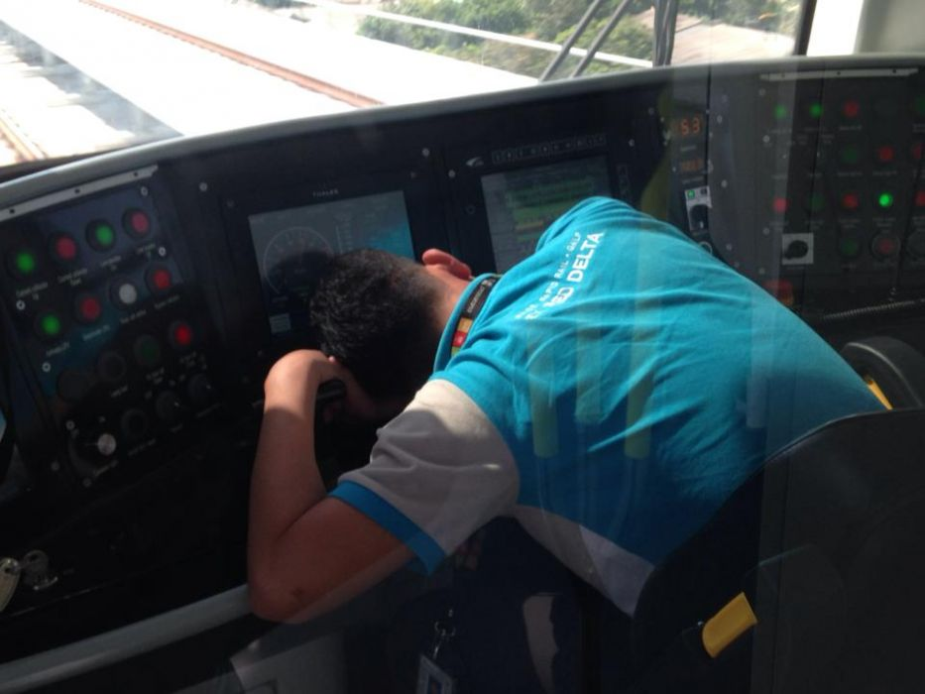
Real-World Safety Statistics: Do CVD Drivers Cause Accidents?
  Empirical Data from Major Accident Databases
  ERA Annual Safety Reports 2010–2023 ; FRA Office of Safety Analysis databases
  Couses of major accidents:
  Primary Etiologies of SPAD (Signal Passed at Danger)
  Fatigue, circadian disruption, and chronic sleep deprivation.
  Cognitive distraction and high operational workload.
  Extreme meteorological conditions (heavy fog, blizzards, solar glare).
  Not a single major rail accident in the modern signaling era has been causally attributed to congenital CVD!

Slide 7
Real-World Safety Statistics: Do CVD Drivers Cause Accidents?
“That’s why there aren’t any accidents like that—because we’ve been weeding them out for 150 years!”
Epidemiology, Test metrology, Probability theory (e.g., Bayes’ theorem & the Fermi estimate)
1830-1880 – 8 % colour blind drivers
1877-1920 – test with low sensitivity (30-50 % CVD passed!)
From 1917 – Ishihara test (Circumstances? Memeorising?)
2011 – London Underground, 3500 CAD test; because of privacy and labor law, they do not disclose specific details – but there were CVD)
Probability test and Fermi estimate: 1875-2025 – 100 - 200.000 CVD!

Slide 8
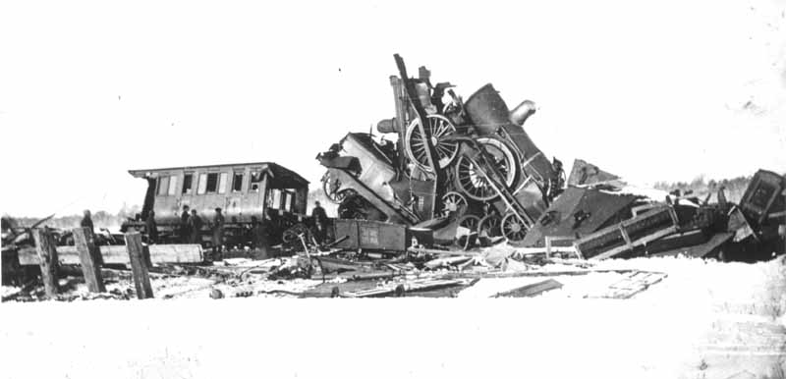
Historical Deconstruction: The 1875 Lagerlunda Rail Disaster
  November 15, 1875, Sweden
  Single-track mainline collision between 2 express train.
  9 fatalities and 3 severe injuries
  Prof. Alarik F. Holmgren hypothesized the driver was colorblind.
  BUT!
  The crew perished in the wreckage — no posthumous vision test could be done!!

Slide 9

The Scientific Fraud & Political Exploitation of Lagerlunda
  Holmgren’s "Coup de Théâtre" tests (July 1876)
  Manipulated relative luminance (brightness) rather than chromaticity, intentionally inducing error.
  Capitalized on public hysteria to market his proprietary Worsted Yarn Test
  Historiographical Re-evaluation (Mollon & Cavonius, 2012; Squire et al., 2005)
  Court records contain zero references to color blindness.
  Judicial verdict: Stationmaster sentenced to 6 months imprisonment for procedural violations.
  There were not even sophisticated colored light signals!!

Slide 10
Why Did the False Dogma Endure for 150 Years?
  The Comfort of the Biological Scapegoat:
  Cheaper to blame an immutable congenital defect than to admit lines were underfunded and lacked interlocking.
  It was easier and cheaper to convince travelers this way than to spend much on improvements.
  Scalability and Simplicity of Testing:
  Holmgren’s wool test was fast, cheap, and required no ophthalmological training.
  Lay clerks could screen and dismiss large crowds of applicants within minutes.
  Institutional Inertia & Regulatory Fear
  Rapidly adopted across Europe and North America via a psychological domino effect.
  Evolved into an untouchable administrative tradition that outlived the mechanical signaling era.

Slide 11
Dichromacy (Color Blindness) versus Anomalous Trichromacy (Color Vision Deficiency)
  Total achromatopsia can indeed be critical
  The overwhelming majority of men identified during railway medical screenings have only abnormal trichromatic vision
  They perceive all three primary colors; only their spectral sensitivity curves are shifted. (Clinical diagnosis of color vision deficiencies (Anomaloscope vs. reality): Deeb, S. S. (2005). "The molecular basis of variation in human color vision." Clinical Genetics, 67(5), 369–377. )
  The study discusses in detail the physiology of anomalous trichromacy and the discrepancy between laboratory tests and everyday visual performance

Slide 12
Clinical Tests vs. Modern Physical Reality: The LED Factor
  Laboratory vs. Field Environment
  Anomaloscopes and Ishihara plates present low-contrast, reflected pigments under diffuse illumination.
  Modern railway signals are high-intensity, point-source LED arrays with narrow spectral bandwidths.
  Empirical Findings: Cole & Maddocks (2008)
  Anomalous trichromats distinguish pure, saturated LED colors (CIE primary red, green, yellow) with near-100% accuracy.
  Recognition is heavily augmented by luminance contrast and high spectral saturation.
  Signal lamps are position-coded (e.g., top red, bottom green).
  Train drivers read spatial location and aspect pattern, not isolated wavelength hues.

Slide 13
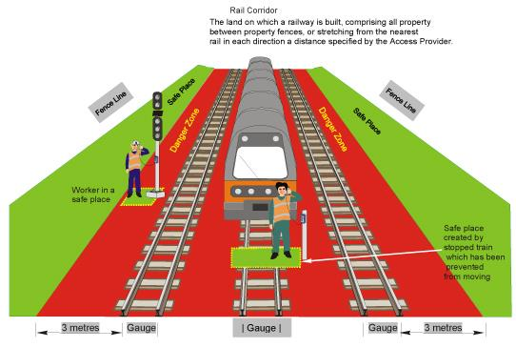
Functional Occupational Analysis: Danger Zone & Track Maintenance
  Hungarian legislation automatically excludes individuals with color vision deficiency—among other areas—from all positions involving work within the safety envelope/danger zone (2.5 meters from track center).
  UNREALISTIC!

Slide 14
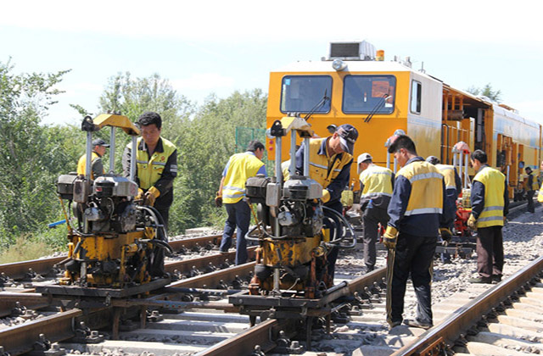
Functional Occupational Analysis: TRACK MAINTENANCE
In the case of track workers, telecommunications, power supply, and interlocking/signaling roles, the fundamental principle of accident prevention is that workers must detect an approaching railway vehicle in time!
Detecting an approaching train is not a matter of color vision!
The worker perceives the gigantic moving silhouette and the mandatorily sounded horn signal.
The yellow and red warning boards they must observe are completely distinct both geometrically and in their patterns (shape-coded signals).

Slide 15
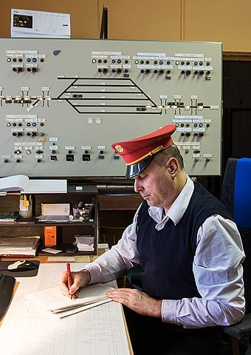

Functional Occupational Analysis: TRAFFIC CONTROL (eg. Dispatchers)
  Inside the office:
  Traffic control consoles and monitors are high-contrast, backlit digital interfaces.
  Track occupancy and signal aspects are indicated by sharp, bright, position- and track-layout-bound graphical elements
  Out on the platform (Train dispach):
  The daytime dispatch baton (paddle)—is an object of specific geometry (circular, with a broad white rim and green interior).
  The meaning of night lantern signals is determined by the direction and rhythm of movement.
  In practice, a train dispatcher's work is determined by shapes, spatial positions, standardized gestures, and high-contrast digital displays.

Slide 16

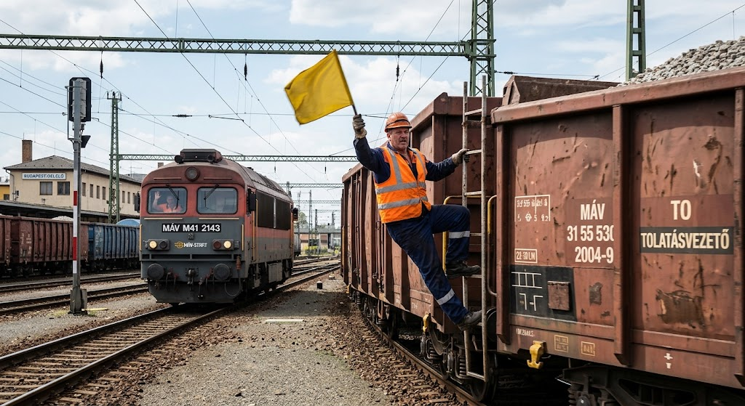
Functional Occupational Analysis: Shunting Personnel (Eg. Yard Switchmen)
Directed via live voice communication over closed-circuit digital radio networks
Auxiliary hand signals are still given, the signal's message is conveyed by the movement geometry of the implement

Slide 17
Functional Occupational Analysis: Locomotive Drivers
The Risk of "Degraded Mode„
If the modern onboard cab signaling system (train control system) fails, the train driver must revert to conventional, visual driving. Than they must rely 100% on lineside optical signals.
Branch Lines and Outdated Infrastructure
Lineside cab signaling is often not installed on branch lines or industrial sidings.
The above concerns are now largely superseded by modern technology and optometric facts:
Position and Luminance
Primacy of Onboard Driver-Machine Interfaces (DMI)
Automatic Intervention

Slide 18

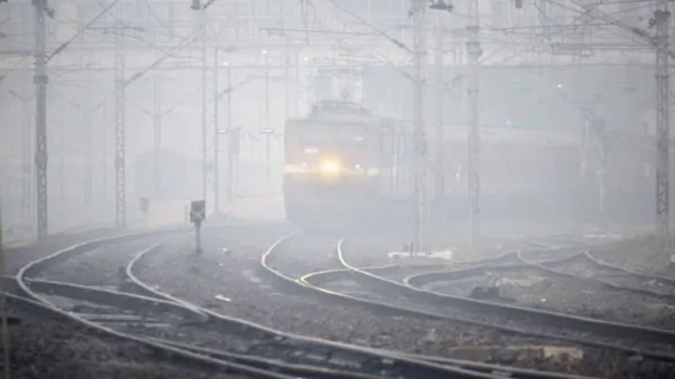
The Weather Factor: Fog, Snowstorms, and Biological Limitations
In extremely dense fog or torrential snowfall, a train driver with perfect color vision is just as "blind" as an individual with color vision deficiency.
Track-mounted balises/magnets or track circuits transmit the information to the locomotive's onboard computer via radio frequency/electromagnetic induction.
Despite heavy snowfall, the train driver sees on their monitor what aspect the next signal — still invisible to the naked eye — is displaying.

Slide 19
The Weather Factor: Fog, Snowstorms, and Biological Limitations
The Conclusion:
Under critical external conditions, the human eye alone is unreliable.(fog, snow, blinding glare)
The system was optimized for instrumented operation (onboard data transmission).
Biological color vision is degraded to a secondary, redundant factor.
Today's railway safety no longer hinges on the human eyeball, but on software.

Slide 20


International Regulatory Paradigms: Moving Beyond Blanket Bans
In the United Kingdom, requirements were revised based on extensive research published by the RSSB in 2016.
If an applicant fails the clinical Ishihara test, they are entitled to a practical lantern test (e.g., Holmes-Wright Lantern test) or field simulation.
Australian railway health standards (National Standard for Health Assessment of Rail Safety Workers) link exemption in Category 2 and Category 3 roles to a functional field assessment.
(See: National Transport Commission, Australia (2017/2024). "National Standard for Health Assessment of Rail Safety Workers." Accordingly, the Australian regulatory tier system favors risk-based and conditional employment in the railway sector. )

Slide 21
Labor Market Realities & The Socioeconomic Cost
According to widely accepted research projected onto the Caucasian male population, approximately 8% of the male population is affected by some degree of color vision deficiency.
(See: Nathans, J., et al. (1986). "Molecular genetics of human color vision: the genes encoding blue, green, and red pigments." Science, 232(4747), 193–202.)
Amid the current demographic crisis and the labor shortages in manual and operational positions, it is unacceptable that, because of a theoretical laboratory dogma, we are closing the door to a career in railways for tens of thousands of healthy young people who are eager to work.

Slide 22

Strategic Policy: A 4-Step Reform Framework
  Legislative Amendment
  Abolish indiscriminate blanket bans and define safety-critical roles by genuine task demands.
  2. Tiered Diagnostic Protocol
  First-line screening: Pseudoisochromatic plates (Ishihara).
  Second-line functional test: Validated lantern tests (e.g. CAD test, simulated field trials).
  3. Ergonomic Infrastructure Standardization
  Complete the transition to narrow-band, high-luminance LED optics across all lineside signals.
  Multiple coding of the shape and position should be made mandatory for all static and digital displays.
  4. Conditional Certification
  Permit anomalous trichromats to operate within instrumented (ETCS) corridors or specific operational branches.

Slide 23
Dismantling the 150-Year-Old Dogma
The 1875 Lagerlunda accident was an operational and administrative failure, not a medical consequence of color blindness.
Rail transport has transitioned from oil lamps and single-track telegraphs to LED optics, DMI cab signaling, and digital train protection.
Occupational ophthalmology and regulatory authorities must align with contemporary visual psychophysics.
It is time to replace dogma with evidence: Shift from categorical exclusion to functional, competence-based assessment.
Open the doors of the railway to this group—which represents nearly 10% of the male population

Slide 24
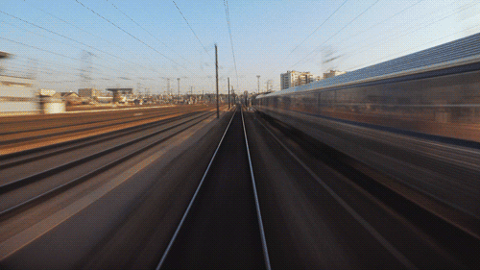
THANK YOU FOR YOUR KIND ATTENTION!
IT IS TIME TO SWITCH TRACKS!

