Slide 1


A criteria-based protocol for fundus examination
in railway fitness assessment
SNCF — Railway medical fitness, France
Dr Fabien GARATTINI
Chief Medical Officer — Railway Fitness, SNCF
Accredited Medical Examiner, French Ministry of Transport
UIMC Congress · Lisbon · 30 September 2026
Notes:
Good morning. My name is Fabien Garattini, I am the referring physician of the Paris-Est railway medical fitness centre — the largest in France — and a member of our national fitness commission.
I want to talk about an examination we perform, why we performed it, and what we found when we finally looked at what it actually produced.
This is a talk about the fundus examination. But it is really a talk about what happens to a medical protocol when the specialist it was designed around is no longer there.

Slide 2

SNCF RUNS ITS OWN MEDICAL SERVICES
Not outsourced. In-house, salaried, and part of the company
154 479
employees followed by our occupational health service, of whom 66 149 hold safety-critical duties.
Occupational health
Care medicine
Railway fitness
Prevent occupational risk and protect health at work.
A company choice: general practice and specialist care provided in-house, under the railway social security scheme.
A legal obligation on every railway undertaking: ensure that safety-critical staff present no risk to operations.
Alongside them:
a psychological support unit · three medical analysis laboratories · toxicology and epidemiology units
SNCF Optim’services – Services Médicaux | UIMC Congress, Lisbon 2026
2
Notes:
A word first about who we are
Click. SNCF runs its own medical service. It is not outsourced. Our doctors and nurses are salaried employees of the company. We follow 154 479 people in occupational health, and of those, 66 149 hold safety-critical duties.
Click. That service has three distinct branches. Occupational health, which is a legal obligation on any employer in France. Care medicine, which is a company choice: our permanent staff receive general and specialist care in-house, under the railway social security scheme. And railway fitness, which is the legal obligation that falls on every railway undertaking.
Click. Alongside them we run a psychological support unit, three medical analysis laboratories of our own, and specialist toxicology and epidemiology units.

Slide 3
THE SCALE OF IT
Key figures, 2025
OCCUPATIONAL HEALTH
101 592
86
97
246
medical visits a year
medical practices
occupational physicians
occupational nurses
CARE MEDICINE AND LABORATORIES
138 485
56
3
52 640
medical appointments a year
practices open to care medicine
laboratories : Paris, Lyon, Bordeaux
laboratory files a year
SNCF Optim’services – Services Médicaux | UIMC Congress, Lisbon 2026
3
Notes:
Click. Occupational health: 101 592 medical visits a year, across 86 medical practices, with 97 occupational physicians and 246 occupational nurses.
Click. Care medicine: 138 485 appointments a year, in 56 practices, plus our own three laboratories in Paris, Lyon and Bordeaux, handling 52 640 files a year.
Click. I show you this for one reason. This is a hospital-sized organisation sitting inside a transport company, and it is the reason a systematic examination was, for a very long time, affordable for us.

Slide 4
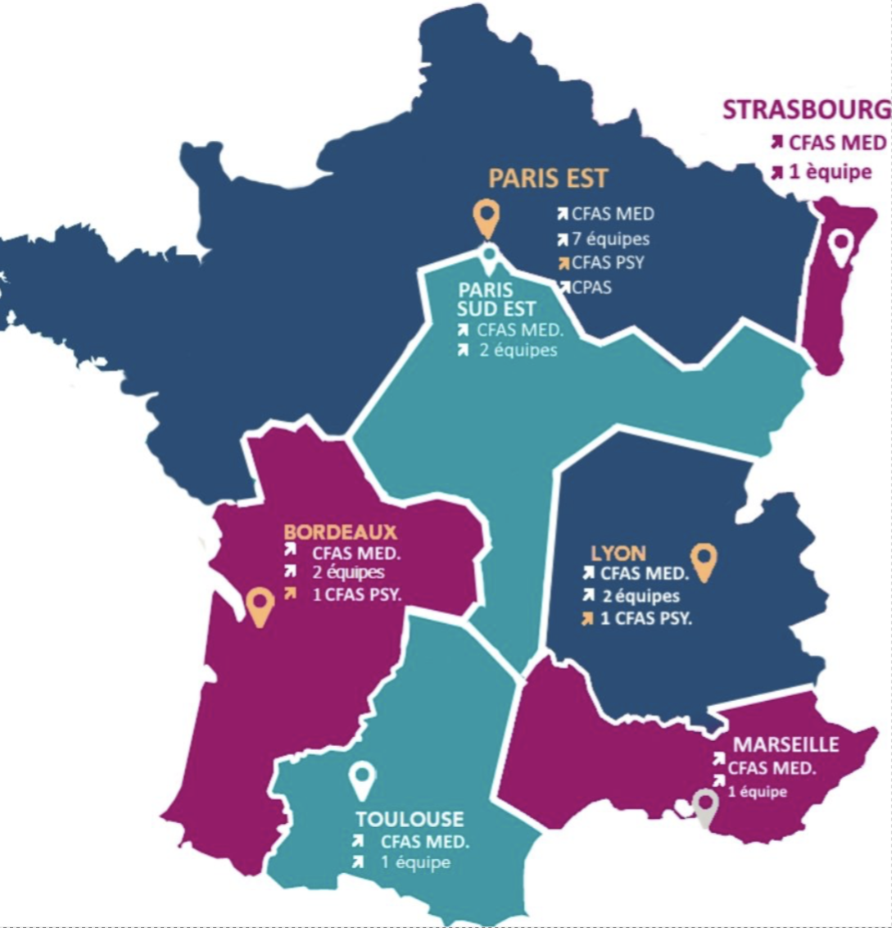
RAILWAY FITNESS
What we see, where we are, and how a decision can be challenged
66 149
36 600
8 580
<2.5 %
employees in safety-critical duties
fitness certificates a year
psychological opinions a year
end in permanent unfitness
7
fitness centres — medical
A fitness decision can be challenged.
3
fitness centres — psychological
Who
The employee, or the employer
1
central scheduling centre, Paris
Within
Two months
To whom
The Commission ferroviaire d’aptitudes
Held by
The Ministry of Transport
CFAS MED = medical centre · CFAS PSY = psychological centre · CPAS = scheduling · équipes = teams
SNCF Optim’services – Services Médicaux | UIMC Congress, Lisbon 2026
4
Notes:
This is the part of the service I work in.
Click. We follow 66 149 employees in safety-critical duties. We issue 36 600 fitness certificates a year, and 8 580 psychological opinions. And about two point five per cent of our assessments end in a permanent unfitness decision.
Click. Here is the network. Seven medical fitness centres — Paris Est, Paris Sud Est, Strasbourg, Lyon, Bordeaux, Toulouse, Marseille. Paris carries seven teams on its own.
Click. Three of them also carry the psychological assessment, and one unit in Paris schedules the whole national activity.
Click. A fitness decision can be challenged. By the employee — and also by the employer. Within two months. Before a national commission. Whose secretariat is held by the Ministry of Transport. I sit on it.

Slide 5
WHY WE HAD Systematic Fundus Examination
In the building, not on call
For most of our history, ophthalmologists sat inside the fitness centres.
The fundus was performed in the same visit
It was read on the spot
No image was sent to an external ophthalmologist. No report was awaited.
The fitness physician signed the certificate on the same day
So a systematic fundus was part of a routine examination
Examining everybody was never a scientific position. It was the easiest option available.
SNCF Optim’services – Services Médicaux | UIMC Congress, Lisbon 2026
5
Notes:
To understand everything that follows, you need to know how we used to work.
Click. For most of our history, an ophthalmologist sat inside the fitness centre. Not on call, not under contract in town. In the building.
Click. The patient never left. The fundus was performed in the same visit, in the next room.
Click. It was read on the spot. No image was sent anywhere. No report was awaited.
Click. The fitness physician signed the certificate, the same day.
Click. So a systematic fundus cost us almost nothing. It was part of a routine examination, performed by a specialist who was already there.
Click. Which is the hinge of this whole talk : examining everybody was never a scientific position. It was the easiest option available.

Slide 6
THEN THE OPHTHALMOLOGISTS LEFT
And we had to find another way
France has a national shortage of ophthalmologists. It is not going to reverse.
Our first step : orthoptists. In France, an orthoptist is a paramedical professional trained in vision — three years of study, working under medical supervision.
They do the whole visual assessment
But not the fundus
Acuity · visual field · colour · contrast · glare · binocular vision · motility · refractometry · keratometry · intraocular pressure. In practice they meet all of our demand, and meet it well.
French law does not allow them to perform it, and they cannot carry the ophthalmological judgement a fitness decision sometimes needs. They were never meant to replace a specialist.
So they needed a rule : when to refer to an ophthalmologist in railway fitness medicine ?
SNCF Optim’services – Services Médicaux | UIMC Congress, Lisbon 2026
6
Notes:
Click. Then the ophthalmologists left. France has a national shortage, it has reached our fitness centres, and it is not going to reverse.
Click. Our first step was to bring in orthoptists. In France an orthoptist is a paramedical professional trained specifically in vision / three years of study, working under medical supervision. They are not doctors, and they are not opticians.
Click. And they do a great deal. The whole visual assessment : acuity, field, colour, contrast, glare, binocular vision, motility, refractometry, keratometry, intraocular pressure. In practice they meet all of our demand, and they meet it well.
Click. But not the fundus. French law does not allow them to perform it, and they cannot carry the ophthalmological/medical judgement that a fitness decision sometimes needs. They were never meant to replace a specialist.
Click. So they needed a rule. A written rule telling them when to refer. That is what the rest of this talk is about.

Slide 7
THE PATHWAY
Who sees the eye, and who decides
OPHTHALMOLOGIST
examination and report
YES
A TRIGGER ?
ORTHOPTIC
ASSESSMENT
FITNESS PHYSICIAN
NO — it stops here
FITNESS CERTIFICATE
The orthoptist does not decide. The ophthalmologist does not decide. The certificate is the fitness physician’s.
SNCF Optim’services – Services Médicaux | UIMC Congress, Lisbon 2026
7
Notes:
Here is the pathway, in its simplest form. I will build it up.
Click. Everything begins with the orthoptic assessment. Everyone, every time ( candidates before assignment, and staff at every periodic review.)
Click. At the end of it, one question : is a trigger present ?
Click. If yes, the person goes to an ophthalmologist, who examines and writes a report.
Click. If no, it stops there. No referral, no delay, no waiting.
Click. In both cases the file comes back to the fitness physician.
Click. Who issues the certificate.
Click. And I want to underline this, because it is what makes the whole thing defensible. The orthoptist does not decide. The ophthalmologist does not decide either / he gives an opinion. The certificate is the fitness physician's. We changed who gets consulted. We did not change who is responsible.

Slide 8
Do we actually need a fundus examination ?
First : why were we doing it at all ?
French Order of 6 August 2010
“Degenerative retinal lesions liable to cause detachment” — a ground for unfitness.
This is the sentence that has been read, for decades, as obliging us to look.
And nothing else asks for it.
Directive 2007/59/EC and Regulation (EU) 2019/773 require only “absence of progressive eye disease”. Neither mentions a fundus. Nor does any other European text.
One national sentence. That is the whole legal basis.
SNCF Optim’services – Services Médicaux | UIMC Congress, Lisbon 2026
8
Notes:
So we asked ourselves a very simple question. If the orthoptist cannot perform a fundus, do we actually need one ?
Click. And before answering that, a prior question : why were we doing it at all ?
Click. The answer is one sentence, in one national text. The French Order of 6 August 2010 makes degenerative retinal lesions liable to cause detachment a ground for unfitness. That sentence has been read, for decades, as obliging us to look at the back of the eye of everyone we see. Please hold on to the wording : we come back to it in three minutes.
Click. And nothing else asks for it. The European Train Drivers' Directive and the TSI require only the absence of progressive eye disease. Neither mentions a fundus. Nor does any other European text.
Click. One national sentence. That is the whole legal basis for examining sixty-six thousand people.

Slide 9
SO WE LOOKED AT WHAT OUR SYSTEM PRODUCED
One year of decisions, from the top down
36 600
1 179
574
?
certifcates a year
unfitness decisions
of them ophthalmological
and how many needed a fundus
SNCF Optim’services – Services Médicaux | UIMC Congress, Lisbon 2026
9
Notes:
So, rather than argue about it, we looked at what the examination actually produced. One year, from the top down.
Click. 36 600 assessments.
Click. 1 179 permanent unfitness decisions.
Click. Of those, 574 ophthalmological. Very nearly half of everything.
Click. And then the question nobody had asked : of those 574, how many actually needed somebody to look at the back of the eye ?
Click. That last figure is the one we had never looked at, in thirty years of performing the examination.

Slide 10
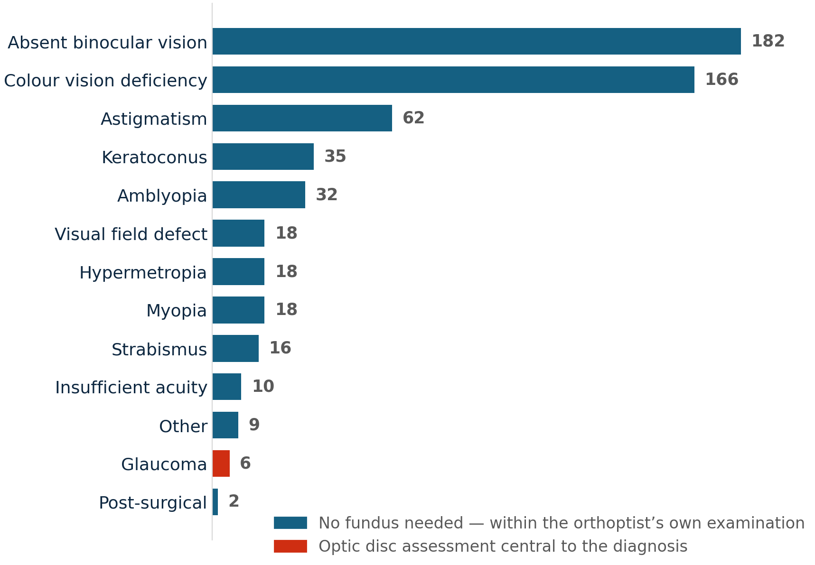
WHAT ACTUALLY MAKES SOMEONE UNFIT
The 574 ophthalmological decisions of 2023, by cause
6
of 574 decisions were glaucoma : the only category in which assessment of the optic disc is central to the diagnosis
And even there, the abnormality was found first by tonometry, which the orthoptist performs.
The fundus never initiated a decision. It confirmed or explained one.
0
retinal detachments. 0 degenerative retinal lesions.
The precise finding our national text asks us to look for did not appear once.
An argument for triggering it. Not for abandoning it.
SNCF Optim’services – Services Médicaux | UIMC Congress, Lisbon 2026
10
Notes:
This is the slide I would ask you to remember.
Here are those 574 decisions broken down by cause. Absent binocular vision. Colour vision deficiency. Astigmatism. Keratoconus. Amblyopia. Refractive errors. Strabismus.
Every one of those is established by an orthoptic assessment. None of them requires anyone to look at the back of the eye.
Click. Six of the 574 were glaucoma. That is the only category in the whole list in which assessment of the optic disc is interesting to the diagnosis. There were also 18 visual field defects, but those are found by perimetry, and their causes run from glaucoma to lesions that are not ocular at all.
Click. And this is the finding that stopped us: zero retinal detachments, zero degenerative retinal lesions. The precise finding our national regulation instructs us to look for did not appear once in a full year.
Click. So we were performing a systematic examination, and its annual yield was six cases of glaucoma : a disease we pick up by measuring intraocular pressure, which the orthoptist does, and then looking at the optic disc. Not by examining the retinal periphery.
I want to be careful here. This is a count of unfitness decisions, not of diagnoses. A fundus that finds a treatable lesion and leads to care rather than exclusion does not appear in this table. That is a real limitation of the figure. But it does not change the direction of the answer.

Slide 11
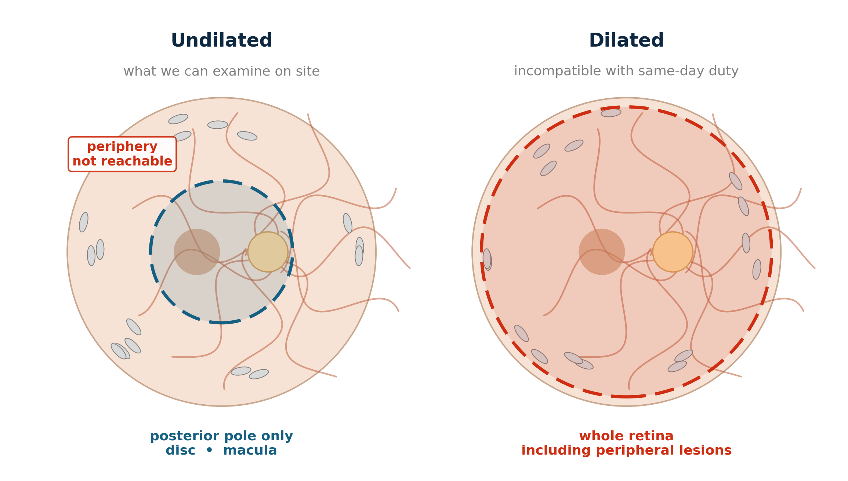
YES — BUT WHAT ABOUT THE FRENCH REGULATION ?
Degenerative retinal lesions liable to cause detachment
Our fundus is undilated.
Undilated shows the posterior pole.
The clause targets the periphery.
So we were never going to find it.
0 degenerative retinal lesions in a full year. That is a finding about our method, not about our population.
Mydriasis is incompatible with driving or returning to duty the same day.
The optic disc and the macula. Nothing beyond.
A detachment begins at the edge of the retina, not at the centre.
SNCF Optim’services – Services Médicaux | UIMC Congress, Lisbon 2026
11
Notes:
So : did we answer the French regulation ? Look at the picture while I take you through it.
Click. Our fundus is undilated. It has to be cause mydriasis is incompatible with driving, or with returning to duty, on the same day. The people we see leave and go back to work.
Click. An undilated pupil shows you the posterior pole. The optic disc, the macula. Nothing beyond.
Click. And the clause targets the periphery. A retinal detachment begins at the edge of the retina, not at the centre. That is where those lesions live : you can see them on the right-hand image, in the ring the left-hand image cannot reach.
Click. So we were never going to find it. Zero degenerative retinal lesions in a full year, in sixty-six thousand people. That number is not telling you something about our population. It is telling you something about our method.

Slide 12
DID IT MATTER ?
Three reasons why the answer is no
The target is lattice degeneration
2% of the general population has it.
1
Detachment is rare
Orders of magnitude rarer. Finding the first says almost nothing about the second.
2
Nobody treats it
Routinely photocoagulated in the 1980s. Abandoned by consensus : it does not prevent detachment.
3
The clause is a survivor. The medicine moved on ; the text did not.
SNCF Optim’services – Services Médicaux | UIMC Congress, Lisbon 2026
12
Notes:
So we were not meeting our own regulation. The fair question is whether that mattered. Three reasons why it did not.
Click. One. What the clause actually targets is lattice degeneration. More than two per cent of the general population has it.
Click. Two. Retinal detachment is rare : orders of magnitude rarer. Finding the first tells you almost nothing about the risk of the second.
Click. Three, and this is the decisive one. Nobody treats it. In the 1980s French ophthalmology routinely photocoagulated these lesions. That practice was abandoned by consensus, because it does not prevent detachment. So even if we found one, we would do nothing about it.
Click. The clause is a survivor. The medicine moved on ; the text did not. That happens, and it is nobody's fault : but it means the examination has been running on inertia for decades.

Slide 13
SO WHERE DOES THAT LEAVE US ?
No case for a systematic fundus.
Which opens the door to orthoptists — for good.
But the undilated fundus is still useful — when something points to it.
Diabetic retinopathy · Age-related macular degeneration · Papilloedema · Glaucomatous disc
All of them sit at the posterior pole — exactly where an undilated view is good.
So we built a referral protocol.
SNCF Optim’services – Services Médicaux | UIMC Congress, Lisbon 2026
13
Notes:
So where does that leave us ?
Click. There is no case for a systematic fundus. Not on the figures, not on the regulation, not on the clinical value.
Click. Which opens the door to orthoptists, for good. If the examination does not have to be performed on everyone, the fact that they cannot perform it stops being a blocking problem.
Click. But ( and this matters ) the undilated fundus is still useful. Not as a screening test on everybody, but as a targeted examination when something points to it. Diabetic retinopathy. Age-related macular degeneration. Papilloedema. A glaucomatous disc. All of those sit at the posterior pole, which is exactly where an undilated view is good.
Click. So we did not abandon the examination. We built a referral protocol : a written rule that tells the orthoptist when the fundus is worth doing. That is what I want to show you now.

Slide 14
THE DECISION TREE
Version 07-2026 — every trigger below is measurable in our centres, on the day
ORTHOPTIC ASSESSMENT
NORMAL
ABNORMAL
Background criteria — asked of everyone
Findings on the assessment itself
Age > 55 and last normal fundus > 3 years
Uncorrectable visual acuity
FUNDUS + OPHTHALMOLOGY REPORT REQUIRED
TYPE 2 DIABETES
Myopia ≥ 6 D · astigmatism ≥ 2 D by keratometry · hypermetropia ≥ 4 D
Previous uveitis
ANY ONE = YES
Visual field abnormality
Type 2 only. Insulin-treated diabetes is incompatible with safety-critical duty in any case, so it never reaches this tree.
MI / TIA / stroke
Unexplained abnormality of contrast and / or glare
Neurological, auto-immune or parasitic disease with ocular involvement
Ocular hypertension ≥ 21 mmHg (corrected)
Ten triggers. Not one of them requires an ophthalmologist to be in the building.
SNCF Optim’services – Services Médicaux | UIMC Congress, Lisbon 2026
14
Notes:
This is the protocol itself. I will build it up as we go.
Click. Everything starts with the orthoptic assessment.
Click. It branches two ways. On the left, background criteria questions we ask of everyone, whatever the examination shows. On the right, the findings of the assessment itself.
Click. Both lead to the same place : a fundus examination with an ophthalmology report. Any single trigger, on either side, is enough. There is no scoring and no weighting ,one yes and the candidate is referred.
Click. Left branch, first trigger : age over 55, with no documented normal fundus in the past three years.
Click. Second : type 2 diabetes.
Click. Then previous uveitis ; a major cardiovascular event — infarct, TIA or stroke ; and neurological, auto-immune or parasitic disease with ocular involvement.
Click. Right branch, first : uncorrectable visual acuity.
Click. Second, the refractive thresholds : myopia of six dioptres or more, astigmatism of two or more, hypermetropia of four or more. And note — astigmatism measured by keratometry, not by autorefractometer. The two do not give you the same number, and the difference matters at two dioptres.
Click. Then visual field abnormality ; unexplained loss of contrast or disabling glare ; and ocular hypertension at or above 21 millimetres of mercury.
Click. Two clarifications. When we say diabetes here, we mean type 2. Insulin-treated diabetes is incompatible with safety-critical duty in any case in France, so those patients never reach this tree at all.
Click. And within type 2, this is the one exception to everything else on the slide, which I will come to next.
Click. Here is what I would ask you to take away. Ten triggers — and not one of them requires an ophthalmologist to be in the building. Every single one is measurable by the orthoptist, on the day, with the equipment we already have. That is what makes this work in a centre that has lost its specialist.
A word on how the thresholds were set, because I think the method travels better than the numbers. We began with the regulatory review, then the evidence on what routine fundus screening actually finds in asymptomatic working-age adults. Then we took the draft to Professor Brézin at Cochin Hospital in Paris ( an academic ophthalmologist with twenty-five years of railway fitness experience ) and he arbitrated each threshold individually. That is where fifty-five came from. And it was then ratified by our national medical committee and issued, with its reasoning written down, to every physician who has to apply it. That last part matters : a rule whose reasoning is written down, and whose author the physicians respect, gets applied. One issued without either is quietly ignored.

Slide 15
ONE EXCEPTION
Type 2 diabetes
Dilated. Performed outside if needed. Under 12 months. Never deferred.
The danger is at the periphery
Vitreous haemorrhage. Sudden loss of vision, at a safety-critical post.
Undilated is not a valid method
National guidance says so in terms. Sensitivity too low to screen.
Macular oedema needs relief and OCT
It can exist with normal acuity. Neither is available on site.
SNCF Optim’services – Services Médicaux | UIMC Congress, Lisbon 2026
15
Notes:
One group is handled differently, and deliberately more strictly : type 2 diabetes. Insulin-treated patients are already unfit for safety-critical duty in France, so this slide is about the others.
Click. For them : a dilated examination, performed outside, less than twelve months old, and never deferred to the next visit.
Click. First reason. The danger is at the periphery : ischaemia, new vessels, and then vitreous haemorrhage. That means a sudden loss of vision, at a safety-critical post. It is exactly the event we exist to prevent.
Click. Second. Undilated is not a valid method. Our national guidance says so in terms : sensitivity too low to be accepted as screening for diabetic retinopathy. That is precisely the examination we can perform on site.
Click. Third. Macular oedema : the commonest cause of visual loss in diabetes ; can exist with normal acuity. Diagnosing it needs a stereoscopic view after dilation, or an OCT. We have neither in the centre.
Click. And fourth, the cruel one. Autonomic neuropathy causes miosis, and cataract comes earlier. So the undilated view is at its worst in precisely the patient who needs it most.

Slide 16
WHAT WE WOULD LIKE TO ASK YOU
Do you perform a morphological examination of the eye at fitness assessment — fundus, retinal photography, OCT, corneal topography? Systematically, or on defined triggers?
1
Who sees the eye first: an ophthalmologist, an optometrist, an orthoptist, a nurse, a technician? And who decides on referral?
2
SNCF Optim’services – Services Médicaux | UIMC Congress, Lisbon 2026
16
Notes:
Which brings me to what I would like from you. Only two questions, and they are both factual.
Click. First : do you perform a morphological examination of the eye at all / a fundus, a retinal photograph, an OCT, a corneal topography ? And is it systematic, or triggered by defined criteria ?
Click. Second : who sees the eye first ? An ophthalmologist, an optometrist, an orthoptist, a nurse, a technician ? And who decides on the referral ?

Slide 17
Thank you
Dr Fabien GARATTINI
fabien.garattini@sncf.fr
Chief Medical Officer — Railway Fitness, SNCF
Notes:
Thank you for your attention.
The systematic fundus was not a conviction. It was a substitute for information we could not otherwise obtain.
I would be glad to take questions.

