Slide 1


Beyond Track Maintenance: Uncovering Exposure to Crystalline Silica Dust in a Railway Company
Dra. Ana Beltran, MD
Dra. Marta Espinós, MD
Notes:
Good morning.

Slide 2

BACKGROUND
Where we left off in Budapest
241
49
56
occupational hygiene measurements
tasks in Rail Network, Rolling Stock and Operations
workers initially identified as exposed
Agents detected, but occupational exposure limits not exceeded
Exposure mainly in track and overhead-line maintenance
Own health surveillance protocol developed; preventive measures still being rolled out
Two years later
The risk proved more widespread than anticipated. Today: crystalline silica dust only, and how new sources of exposure led us to reconsider prevention and health surveillance.
Notes:
Two years ago, in Budapest, we presented the impact on FGC of incorporating crystalline silica dust, or CSP, and diesel engine exhaust emissions into the regulations on carcinogenic agents.
At that time, we had carried out 241 occupational hygiene measurements covering 49 tasks in the Rail Network, Rolling Stock and Operations areas. The measurements detected the presence of these agents, but the occupational exposure limits were not exceeded.
Based on that assessment, we initially identified 56 exposed workers, mainly in track and overhead-line maintenance.
Because there were no protocols fully suited to our particular context, we developed our own health surveillance protocol and began implementing several preventive measures, some of which were still being rolled out.
When we returned from Budapest, we continued working. What had initially appeared to be a risk confined to a few very specific groups proved to be more widespread than we had anticipated.
Today, we will focus exclusively on crystalline silica dust and on how extending the study led us to identify new sources of exposure and, consequently, to reconsider both our preventive measures and our health surveillance programmes.

Slide 3
OBJECTIVES
Our objectives remain the same
Identify exposed or formerly exposed workers
Characterise their individual exposure
1
2
Implement preventive measures to reduce or eliminate the risk
Adapt health surveillance to each person’s actual level of risk
3
4
Notes:
Our objectives remain the same: to identify exposed or formerly exposed workers, characterise their individual exposure, implement preventive measures to reduce or eliminate the risk, and adapt health surveillance to each person’s actual level of risk.

Slide 4



MATERIALS AND METHODS
Three possible sources of exposure
Extending the assessment identified three possible sources of current or historical exposure to crystalline silica dust
Ballast
Sand
Accumulated dust
Handling, laying and regulating ballast
Used to improve wheel–rail adhesion; reservoirs on the trains are refilled periodically
Deposited on structures close to the track, from several origins; may contain crystalline silica
Track and overhead-line maintenance
All trains
Structures near the track
Notes:
So, what has happened over the past two years?
Extending the assessment enabled us to identify three possible sources of current or historical exposure to crystalline silica dust.
The first is ballast, which mainly affects workers involved in track and overhead-line maintenance.
The second is sand used to improve wheel–rail adhesion under certain operating conditions. All trains have sand reservoirs that need to be refilled periodically.
The third is dust deposited on various structures close to the track. This dust has several origins but, because of where it comes from, it may also contain crystalline silica dust.
Based on this information, we began a new phase of work, which I will now briefly explain.

Slide 5
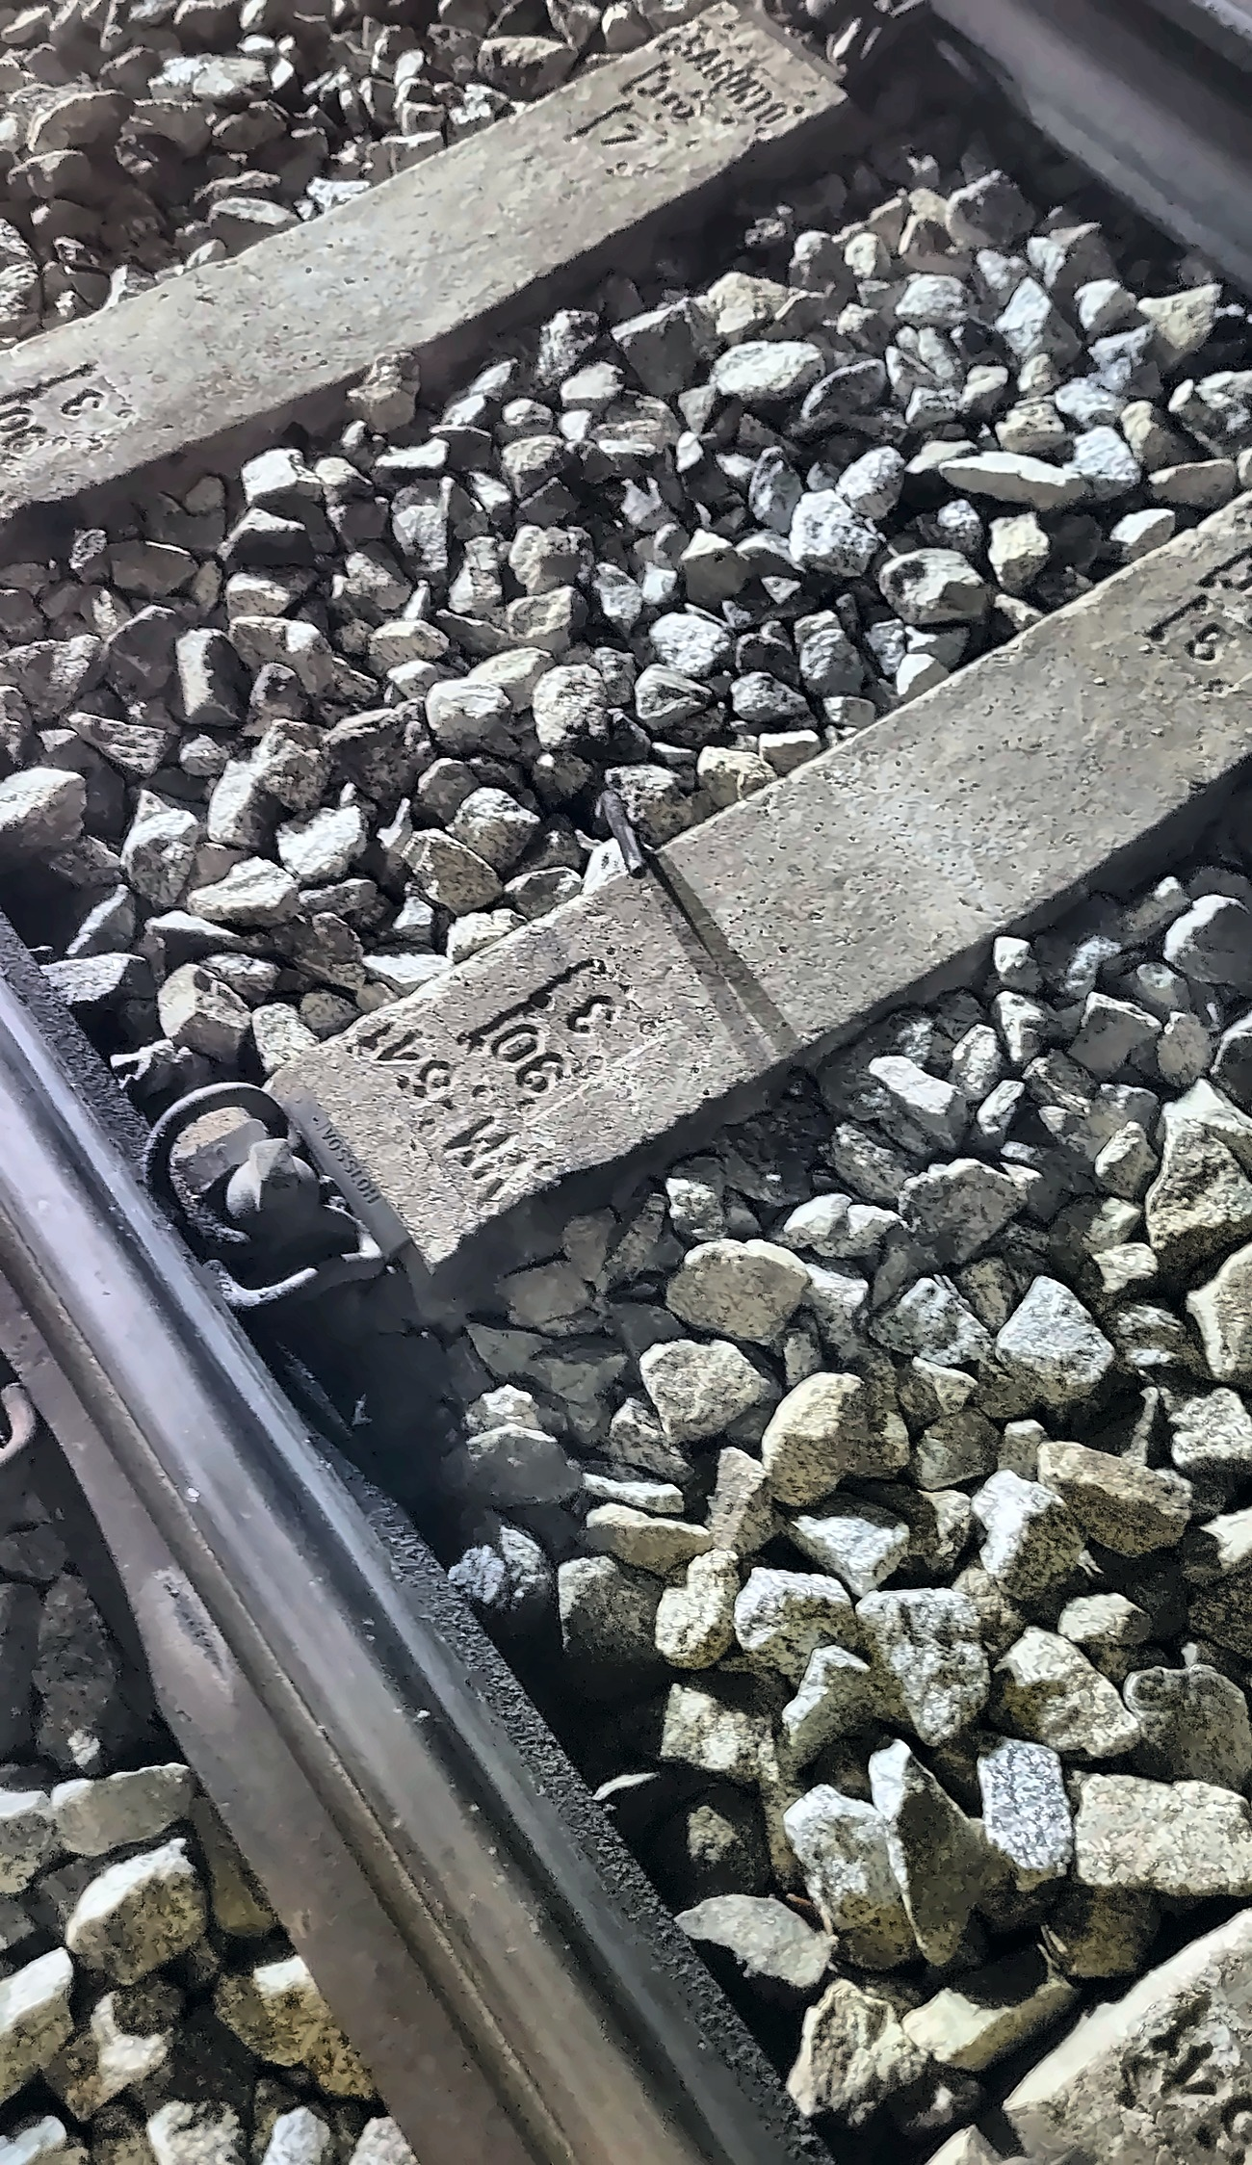
MATERIALS AND METHODS
Ballast
Handling, laying and regulating ballast; operations with railway machinery
Reviewed procedures, task organisation, respiratory protective equipment and work clothing
Reinforced training and measures to reduce dust dispersion
Prevention of secondary exposure: double-compartment lockers, outsourced workwear laundry
Progressive replacement by concrete slab track in some tunnel sections
Notes:
Regarding ballast, we had already presented most of our actions in Budapest.
The initial assessment focused mainly on track and overhead-line maintenance staff, particularly during activities such as handling, laying and regulating ballast, as well as certain operations performed using railway machinery.
Based on the results, we reviewed working procedures, task organisation, respiratory protective equipment and work clothing. We also reinforced training and measures aimed at reducing dust dispersion and preventing the exposure of people who were not directly involved in these activities.
We also implemented measures to prevent secondary exposure and stop dust from being carried outside the work area, including double-compartment lockers in changing rooms and an outsourced workwear laundry service.
At the same time, the company is progressively replacing ballast with concrete slab track in some tunnel sections. This eliminates or reduces the need to handle ballast in those sections and, consequently, reduces potential future exposure.
Therefore, in the case of ballast, our work over recent years has mainly involved consolidating and extending measures that we had already begun to implement.

Slide 6
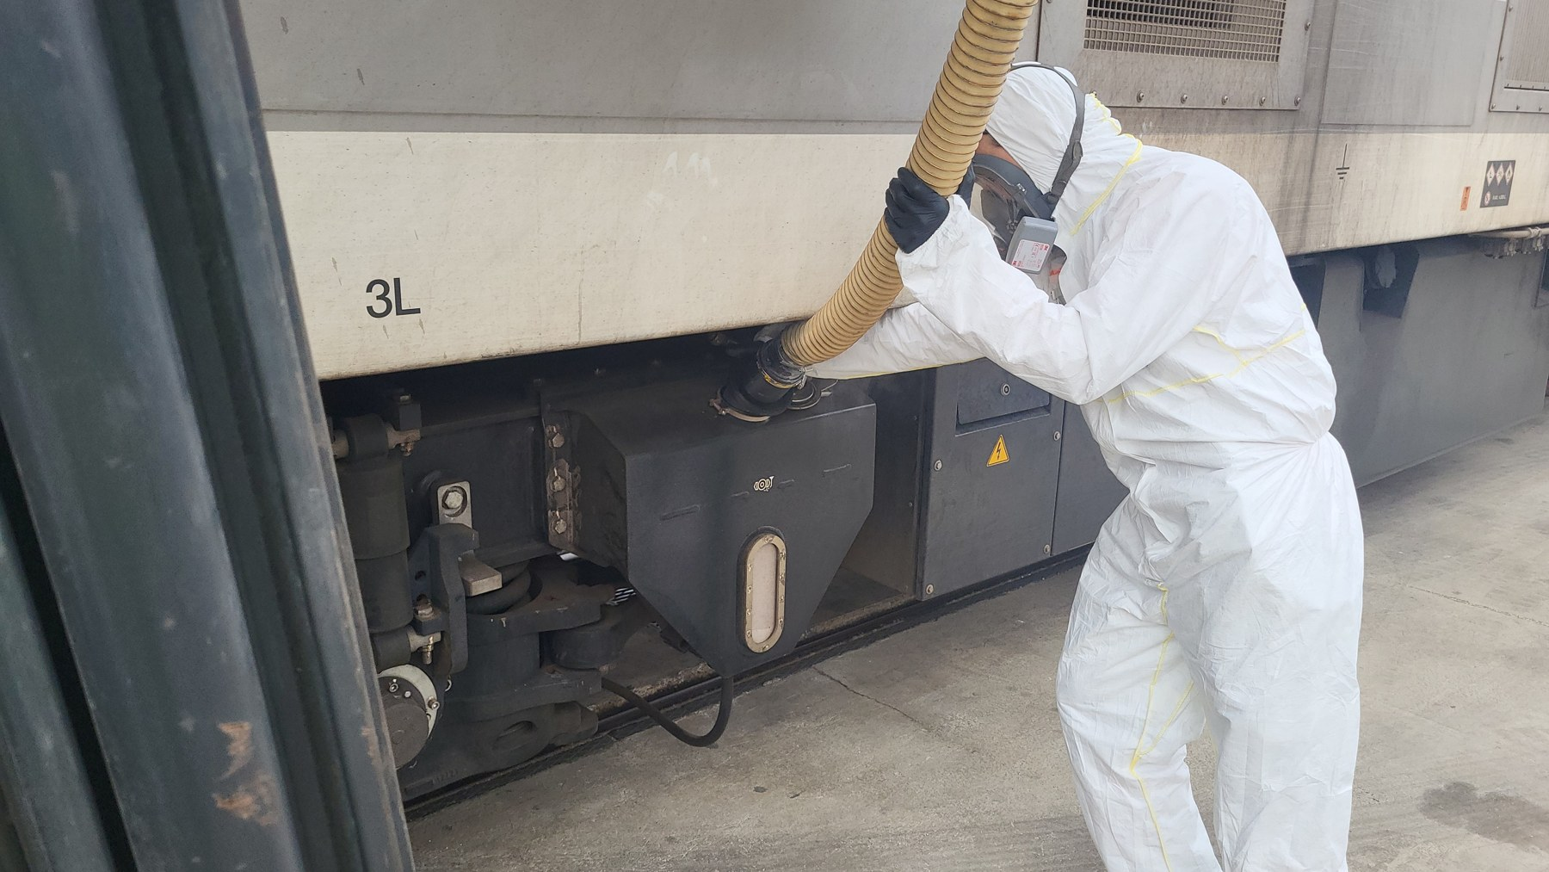
MATERIALS AND METHODS
Sand
Refilling train reservoirs from a silo or large container, mainly in workshop maintenance inspections
Exposure histories hard to reconstruct: task and staff changed over the years, records not exhaustive
Historical records of potentially exposed job roles, supplemented by individual questionnaires
Closed refilling system: improved silo closures and sealed connections to train reservoirs
Notes:
Sand has probably been the most interesting finding of the entire project.
Refilling the sand reservoirs appears to be a very simple task: it involves transferring sand from a silo or large-capacity container into the reservoirs installed on the trains.
Nowadays, this activity is mainly carried out during maintenance inspections in the workshops, by rolling-stock maintenance staff and some train drivers.
However, when we tried to reconstruct the workers’ exposure histories, we discovered a much more complex reality.
Over the years, both the way the task was performed and the people responsible for carrying it out had changed.
Furthermore, the available records were not exhaustive.
This made it extremely difficult to determine who had actually been exposed and for how long.
We therefore decided to begin with historical records for potentially exposed job roles and then supplement this information with individual questionnaires.
From a preventive perspective, we have modified the process to ensure a closed system that prevents dust emissions during refilling.
For example, we have improved the closure systems on the silos and the sealing of the connection points to the train reservoirs.

Slide 7
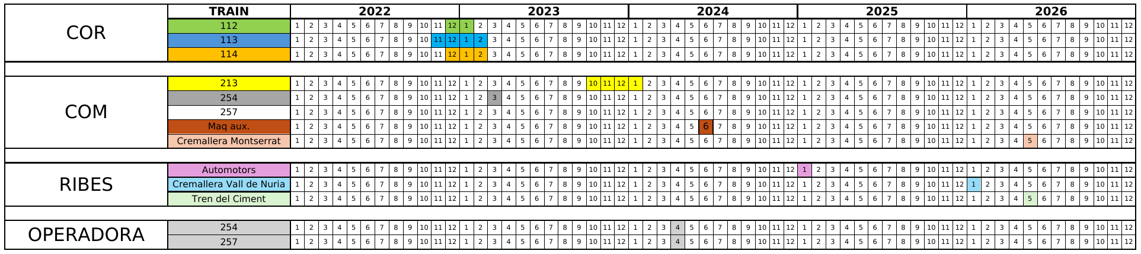
MATERIALS AND METHODS
Replacing silica-containing sand
Progressive replacement by a calcium silicate-based alternative, after numerous safety and operational tests
Validated on selected train units, then extended to the rest of the rolling stock
Working-procedure changes retained despite the new material
Notes:
The other major measure has been the progressive replacement of silica-containing sand with a calcium silicate-based alternative.
Although this may sound like a straightforward measure, it required numerous tests to ensure its safety and operational effectiveness.
Implementation was gradual. We first validated the change on selected train units and then progressively extended it to the rest of the rolling stock.
This timeline summarises the process.
On the left, you can see the different workshops and types of rolling stock. The following columns show the years and months in which the tests and replacements were carried out.
As you can see, this was a lengthy process that took place over several years, and the final changes were implemented this year.
Despite replacing the material, we have retained the changes to working procedures that were originally introduced to protect workers.

Slide 8
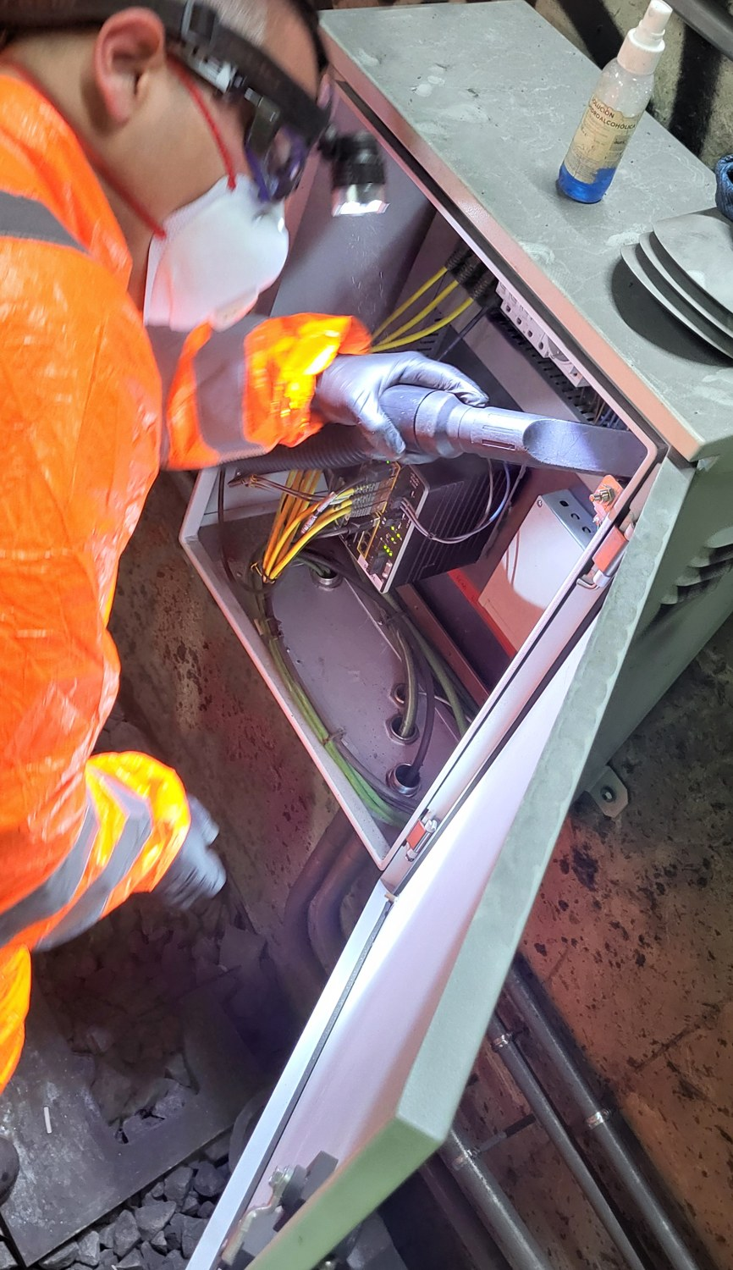
MATERIALS AND METHODS
Accumulated dust
Low but detectable exposure when cleaning cabinets inside tunnels
Communications and railway signalling teams; scheduled cleaning twice a year, always at night and also occasional maintenance work
Previous practice: blowers, which only moved the dust
Now: vacuum cleaning and damp wiping
Reinforced training and correct use of respiratory protective equipment
Notes:
The third source of exposure identified is dust deposited on various structures close to the track.
Our measurements showed low but detectable exposure levels during the cleaning of cabinets located inside tunnels.
This activity is carried out by communications and railway signalling teams. Scheduled cleaning takes place twice a year and always during the night shift, although occasional maintenance work may also be required.
Until recently, these cabinets were cleaned using blowers, which simply moved the dust from one place to another.
The main measure adopted was to replace this practice with vacuum cleaning and damp wiping.
We have also reinforced training and the correct use of respiratory protective equipment.

Slide 9

MATERIALS AND METHODS
Health surveillance: identifying exposed workers
Exposed and formerly exposed workers identified through managers, historical records and employment documents
High internal staff mobility: formerly exposed workers may now be in any area of the company
Detailed occupational history collected with Microsoft Forms, one questionnaire per source of exposure
Individual exposure index (IEI): exposure periods converted to equivalent working days, giving cumulative years of exposure
Surveillance frequency follows the Spanish Ministry of Health silicosis protocol
Forms
3 specific questionnaires
Ballast · Sand · Dust
Notes:
In the area of health surveillance, we had developed our own protocol based on guidelines intended for work involving high levels of exposure, and we had initially applied it to 56 people.
Now, however, we had many more people with low but nevertheless present exposure.
To identify exposed and formerly exposed workers, we consulted managers from the different areas, historical records and employment documentation. One of the main difficulties concerned refilling the sand reservoirs. Nowadays, this task is carried out at specific locations by designated workers during train maintenance activities. In the past, however, it could be performed by any train driver who noticed during a shift that the reservoirs needed to be refilled.
This difficulty is compounded by the high level of internal staff mobility at FGC, which means that formerly exposed workers may now be found in virtually any area of the company.
Each potentially exposed person needed a detailed occupational history in order to characterise the exposure and establish its level.
Because this process was very time-consuming, we decided to use Microsoft Forms questionnaires, which we distributed by email to the workers concerned with the approval of their managers. As the three sources of exposure have different characteristics, we developed three specific questionnaires.
In the sand questionnaire, for example, we ask for the date the person joined the company, whether the person has refilled sand reservoirs, up to three possible risk locations, the number of months worked at each location, the frequency with which the task was performed and its duration.
Using all this information, we calculated what we call the individual exposure index, or IEI. Despite its name, it is not strictly an index, but rather the sum of the different exposure periods converted into equivalent working days. This allows us to estimate each person’s cumulative years of exposure.
Why is this calculation necessary? Because the Spanish Ministry of Health protocol on silicosis, one of the few official documents available, determines health surveillance according to the compliance of the measurements and the number of cumulative years of exposure.

Slide 10
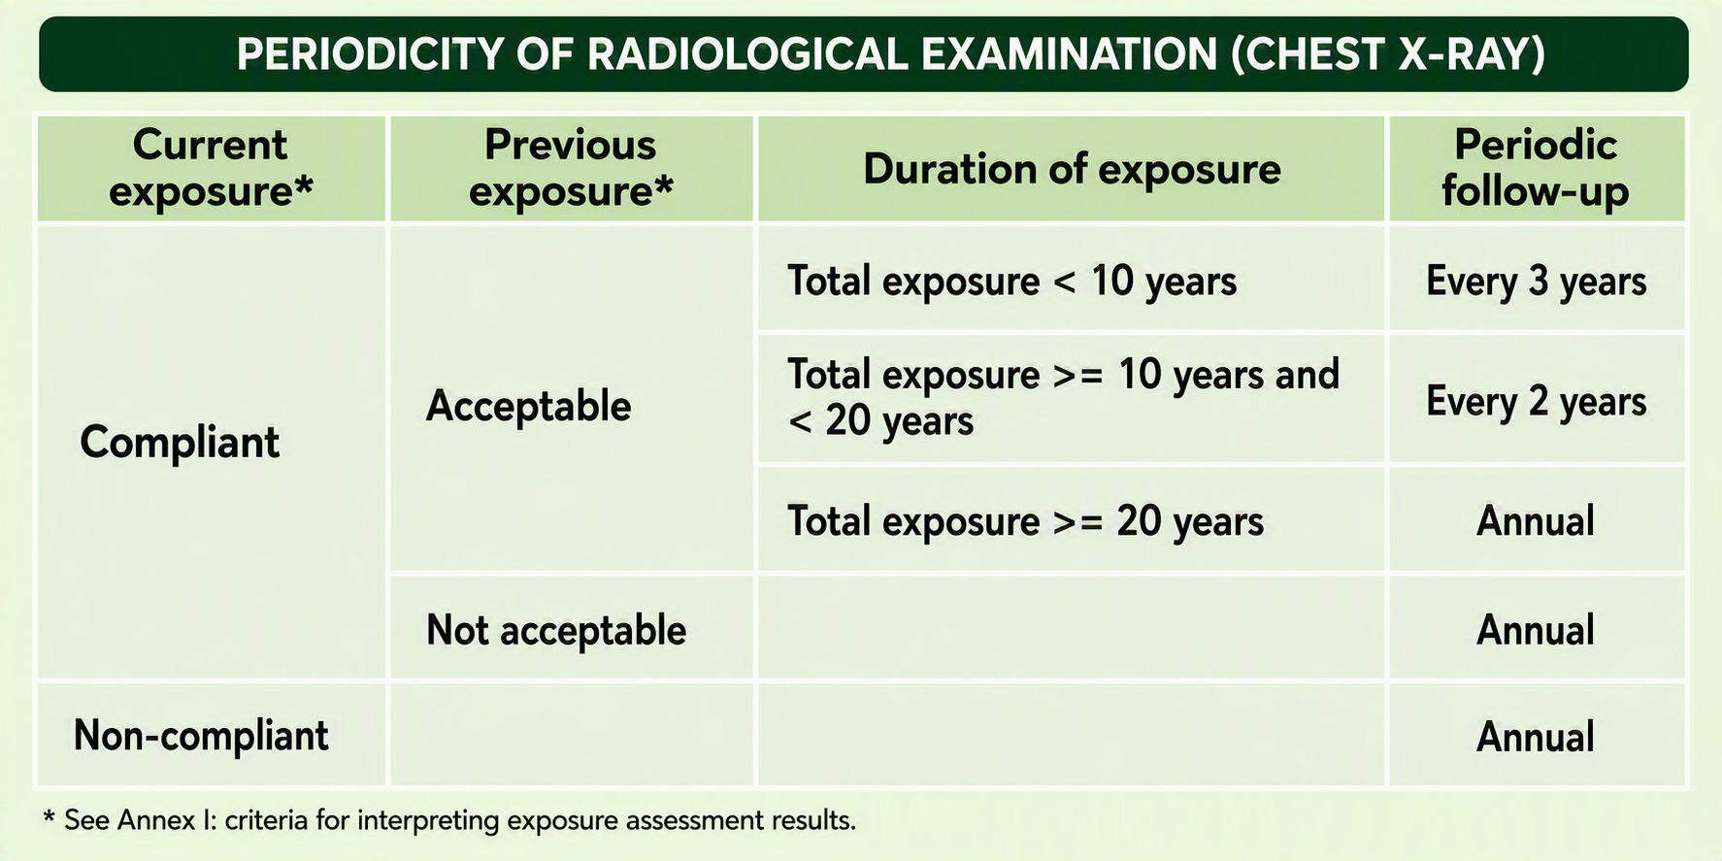
MATERIALS AND METHODS
Health surveillance protocol
Annual nursing appointment
Weight, height, blood pressure
Spirometry
Annual medical appointment
Medical history and new symptoms
Respiratory auscultation
Assessment of spirometry results
Digital clubbing examination
Chest X-ray
Every 1, 2 or 3 years
Depending on exposure criteria (table)
If any abnormality is detected: additional tests or referral to a pulmonology specialist
Notes:
Before applying this method, we consulted several experts and presented them with our proposed calculation. In every case, it was considered an appropriate approach.
The health surveillance protocol for exposure to CSP includes:
An annual nursing appointment, including measurement of weight, height and blood pressure, as well as spirometry.
An annual medical appointment, including assessment of medical history and newly developed symptoms, particularly those related to silica exposure; respiratory auscultation; assessment of spirometry results; and examination for possible digital clubbing.
A chest X-ray every one, two or three years, according to the criteria shown in the table.
If we detect any abnormality, we can extend the assessment with additional tests or refer the person to a pulmonology specialist.

Slide 11
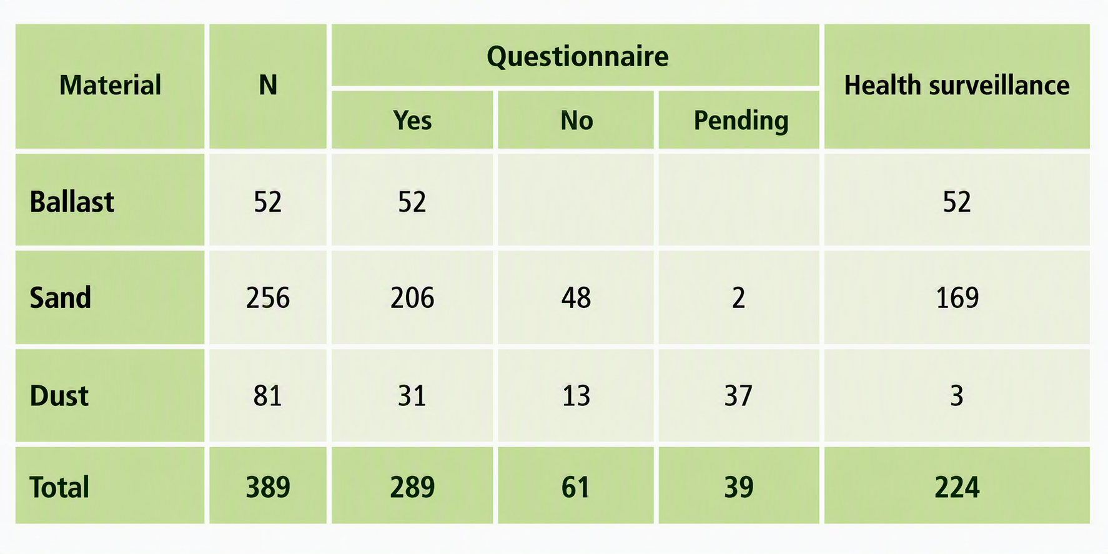
RESULTS
Questionnaire responses
Ballast: 52 responses
Sand: 256 workers identified; 254 responded, 206 had refilled reservoirs
Dust: 81 workers identified; 44 responded, 31 had performed the task
Overall: 289 exposed or formerly exposed workers requiring specific health surveillance
Data collection still being completed
Notes:
We are still completing data collection, but we already have highly representative results.
We obtained 52 responses from workers exposed to ballast.
In the sand group, we identified 256 workers. Of these, 254 completed the questionnaire and 206 reported having refilled sand reservoirs.
In the dust group, we identified 81 workers and received 44 responses, with 31 workers reporting that they had performed the task under study.
Overall, we identified 289 exposed or formerly exposed workers who require specific health surveillance.

Slide 12
RESULTS
Exposure and health surveillance
5.75 years
≈ 6 months
224 workers
Maximum cumulative exposure (sand and dust groups)
Average cumulative exposure (sand and dust groups)
have begun specific health surveillance
Ballast group still under analysis: cumulative exposure expected to be higher
No health condition related to crystalline silica exposure detected so far
Some particularly vulnerable workers need more individualised follow-up
Notes:
Among workers in the sand and dust groups, the maximum cumulative exposure observed was 5.75 years, with an average of approximately six months.
The ballast group is still being analysed, but we know that cumulative exposure will be higher because of the nature of the activity.
To date, 224 workers have begun specific health surveillance.
So far, we have not detected any health condition related to occupational exposure to crystalline silica dust. However, we have identified some particularly vulnerable workers who require more individualised follow-up.

Slide 13
CONCLUSIONS
Three key points
1
Exposure to crystalline silica dust in a railway company extends well beyond the jobs traditionally associated with track maintenance
2
Identifying exposed workers requires a complex historical reconstruction: technical, organisational and employment information
3
Individual exposure assessment tailors health surveillance to each person’s actual risk
In summary
Systematic identification, preventive measures and specific health surveillance have substantially improved the management of crystalline silica dust risk.
Notes:
To conclude, I would like to highlight three key points.
First, exposure to crystalline silica dust in a railway company may extend well beyond the jobs traditionally associated with track maintenance.
Second, identifying exposed workers often requires a complex historical reconstruction combining technical, organisational and employment information.
Third, individual exposure assessment allows us to tailor health surveillance much more closely to each person’s actual risk.
In summary, the combination of systematic identification, preventive measures and specific health surveillance has enabled us to substantially improve the management of crystalline silica dust risk in our railway environment.

Slide 14
Thank you!
Notes:
Thank you very much.

