Slide 1
Noise Hearing & Communication
Timothy J. McCormick, DO, MPH

Slide 2


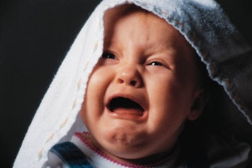
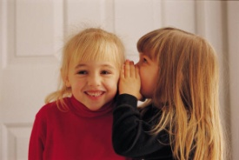
Common noise levels
Immediate Pain:
  Fireworks: 160 dB
  Jackhammer: 130 dB
Extremely Loud:
  Rock concert: 120 dB
  Crying baby: 110 dB
  Impact wrench: 100 dB
Loud:
  Power lawnmower: 90 dB
  Smoke alarm: 85 dB
Non-Hazardous:
  Alarm clock: 70 dB
  Conversation: 60 dB
  Whisper: 30 dB

Slide 3
Typical Sound Levels
Air conditioners 50 –70 dB
Vacuum cleaners 60 – 80 dB
Garbage disposal 70 – 90 dB
Lawn Mower 80 – 90 dB
Chain saw 105 –115 dB

Slide 4
Speech
Conversational speech – 60 –65dB
50 dB hearing level required for speech hearing
Speech – lower frequencies .5kHz, 1kHz, 2kHz, and 3kHz

Slide 5
Hearing acuity- descriptors of hearing loss
(CAOHC)
Normal 0 –25 dB
Slight 25 – 40 dB
Mild 40 – 55 dB
Moderate 55 – 70 dB
Severe 70 – 90 dB

Slide 6
Noise monitoring
For both locomotive engineers and conductors, typical noise exposures are in the range of 80-95 dB, TWA-8.
Exposure can vary greatly depending on:
  Horn placement (over cab or mid-body)
  Windows/doors open vs. closed
  Radio volume
  Age/type of locomotive
  Switching vs. Road Jobs
In general, switching jobs are quieter due to lower-notch work, and less crossings.
More crossings = more horn use, which = more noise

Slide 7
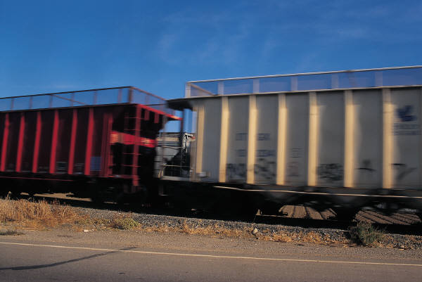
Workplace exposure
There are a few common sources of noise when working on the railroad. These include:
  The locomotive horn
  Cab radios
  Locomotive air brakes
  Switching/Joints
  Engine noise
  Working near retarders

Slide 8
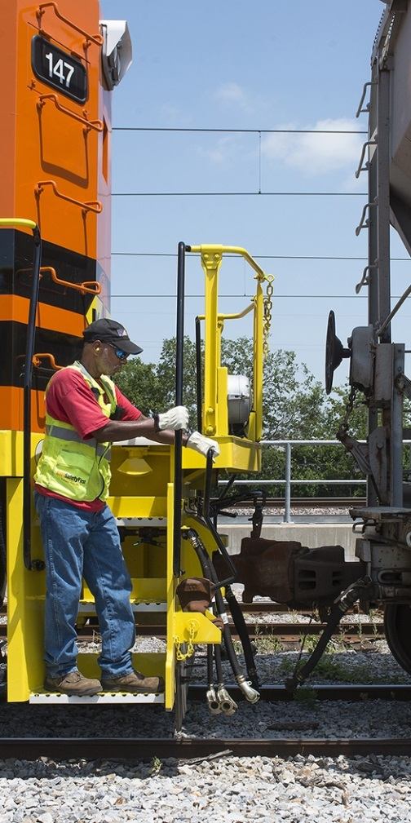
Data Analysis
Yard shifts tend to have the lowest noise exposures
  Crews spend more time in lower notches at lower speeds
  Horn use is very limited
The more the horn is used, the higher the overall exposure
  Mainline/road shifts tend to have the highest exposures because of this. Mainline/road shifts also tend to have longer shift durations.
Most short line railroads perform yard switching or local work. Mainline/road shifts are less common.

Slide 9
242
Except as provided in paragraph (j) of this section, each person shall have a hearing test or audiogram that shows the person's hearing acuity meets or exceeds the following thresholds: The person does not have an average hearing loss in the better ear greater than 40 decibels with or without use of a hearing aid, at 500 Hz, 1,000 Hz, and 2,000 Hz.

Slide 10
(j) A person not meeting the thresholds in paragraphs (h) and (i) of this section shall, upon request, be subject to further medical evaluation by a railroad's medical examiner to determine that person's ability to safely perform as a conductor. In accordance with the guidance prescribed in Appendix D to this part, a person is entitled to one retest without making any showing and to ---------

Slide 11
(e) If the examination required under this section discloses that the person needs corrective lenses or a hearing aid, or both, either to meet the threshold acuity levels established in this section or to meet a lower threshold determined by the railroad's medical examiner to be sufficient to perform as a conductor, that fact shall be noted on the certificate issued in accordance with the provisions of this part.
(f) Any person with such a certificate notation shall use the relevant corrective device(s) while performing as a conductor unless the railroad's medical examiner subsequently determines in writing that the person can safely perform without using the device.

Slide 12
Evolving technology / marketplace
Personal use
  Active noise cancellation – earphones, music etc personal use
Hearing aids
No longer in realm of audiologist dispensing
OTC – FDA allows under law from Congress – intended for mild to moderate hearing loss
Prescription hearing aids – from licensed seller; audiologist involved – remote adjustments
Personal sound amplification – normal hearing ( ie bird watching or other similar activities)

Slide 13
Hearing protection
  Specialized hearing protection with military or police application
    Amplification yet impact noise protection
    Utility in industrial application with need for communication in noise environment.

Slide 14
Intersection now of
Active noise cancellation
New hearing aids technology
Blue tooth setting ability

Slide 15
Hearing protection
  FRA under part 227 emphasizing not to “over protect”
  Reasonable noise attenuation levels

Slide 16
Type of products we are now working with
Earmuff with sound management technology – blocks harmful noise will allow voice or signal frequencies
  Favorable response with employee with some hearing loss and worry about need for aids
Electronic muffs
  Allow sound volume control
  Case reports hearing as well as or better than aids
  Recreational vs industrial application – same brand
  Look for slim line version – lighter weight

Slide 17
New Products
Electronic ear plugs
  True ear plug – but had electronic with four sound setting
  Demonstrated effective communication for hearing impaired in background noise
Combine hearing aids and hearing protection
  Devices now that are true hearing protection ( ie 22 db NRR)
  Bluetooth compatible hearing aids
  Customization – fitted and work with hearing professional

Slide 18
Considerations
Individualized assessment – what works for employee and their work environment
May need to add exemption language to your medical certification
Ie pass with aids but use alternate device
Field testing / Observations
  Communication – know pattern of railroad ( industry ) language

Slide 19
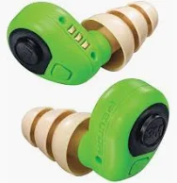
Electronic plugs

Slide 20
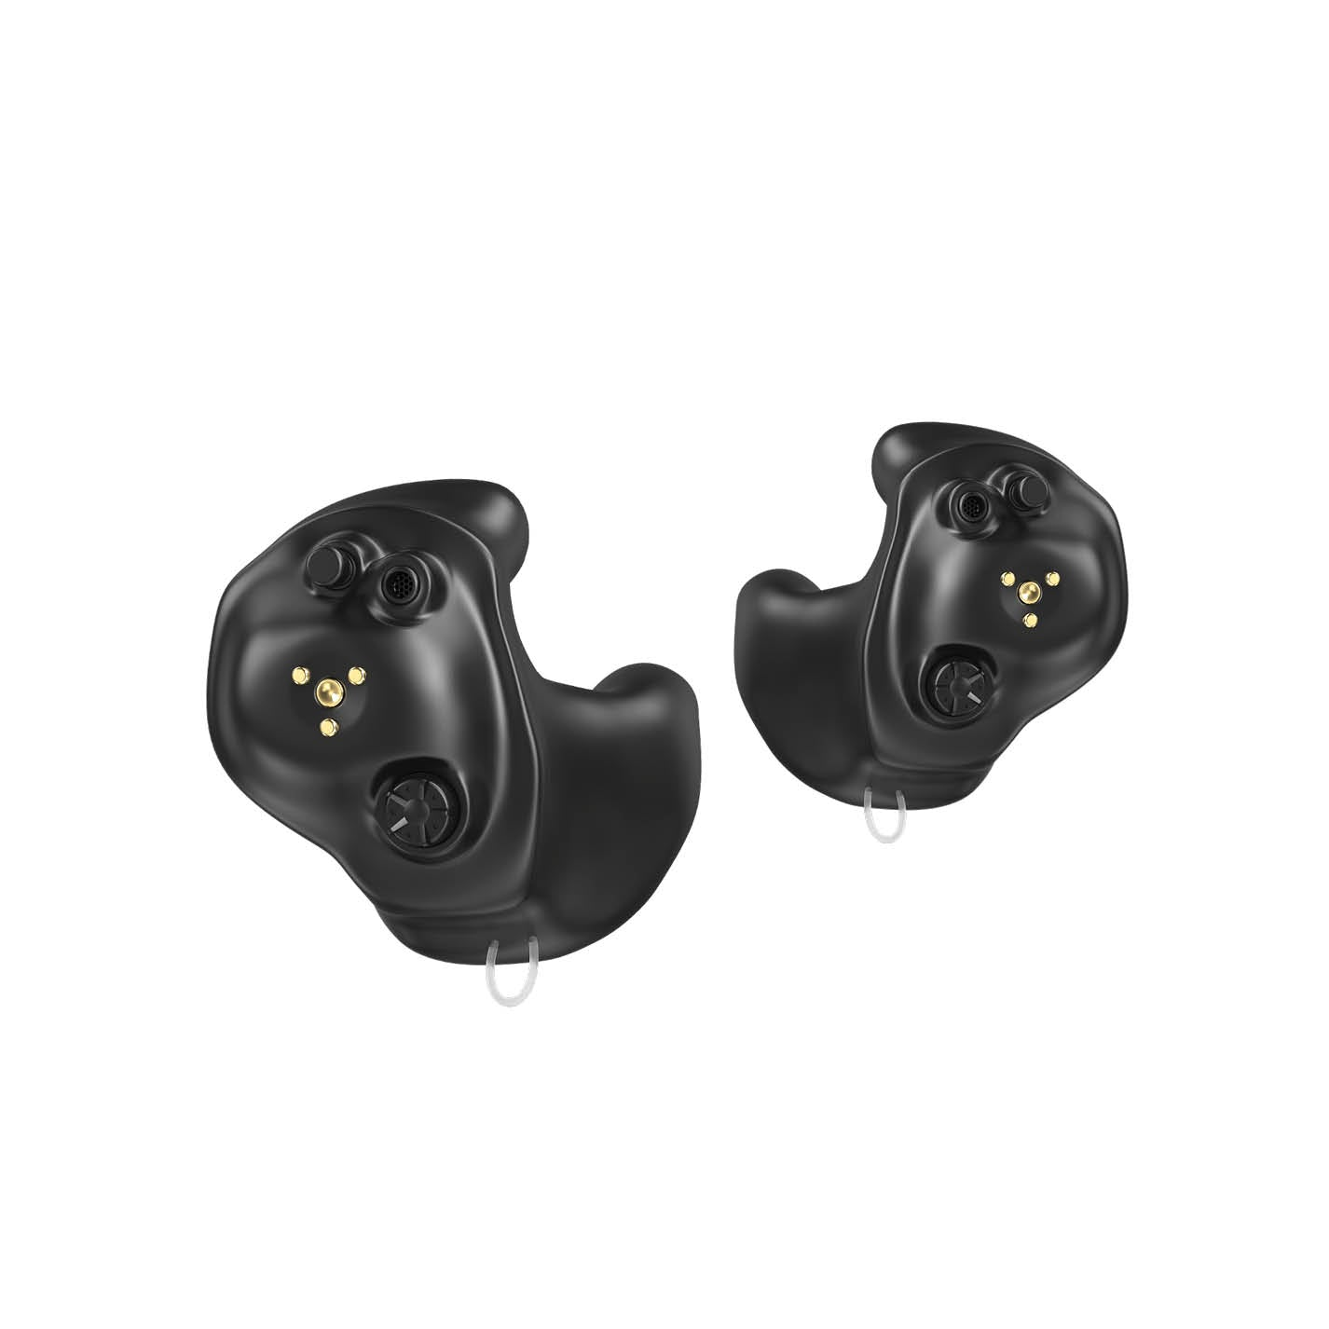
Hearing aid / hearing protection

Slide 21
Tactical Earbuds
Hear the game. Block the pain.
4X Amplified
Sound
Hear footsteps, rustling, and whispers from yards away
27-31dB Instant
Protection
Gunshot noise cut in 0.01 seconds flat
40-Hour
Battery Life
Full hunting season on a single charge

Slide 22
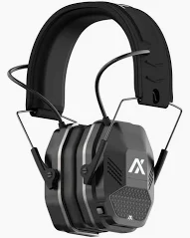
Electronic muffs

